Slide 1



100% ECO-FRIENDLY SUPERIOR TERRA PAVE PRODUCTS
for
PAVEMENT/TRANSPORTATION/SOLAR INDUSTRIES
TERRA PAVE PRODUCTS are the ECO-FRIENDLY, COST EFFECTIVE SOLUTIONS to the CHALLENGES in these MARKETS
www.terrapavetech.com
info@terrapavetech.com
Notes:
My name is David Pham CEO of EEI here to present Terra Pave

Slide 2


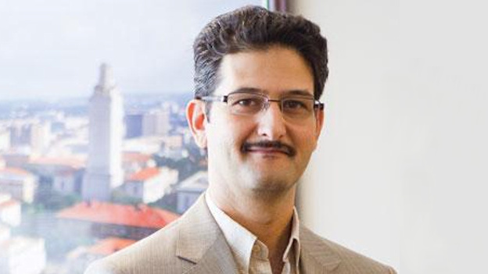


TERRA PAVE TEAM
David Pham BS Elec. E, MBA – CEO
Dr. Yetkin Yildirim, PhD Civil E, President/CTO
+ All the Engineers, Technicians, and Support Staff at
COST-EFFECTIVE, 100% ECO-FRIENDLY,
Water-based polymer products for the Road Pavement, Solar, and Roof Industries
Notes:
That is why OUR TEAM invented Terra Pave Win for the people of Vietnam, Win for the earth environment, Win for Vietnam and USA, Maybe Win for the deficit imbalance

Slide 3


WHY TERRA PAVE ?
Current Asphalt roads/Cement pavements worldwide:
a. INFERIOR
b. LONG LEAD TIME TO COMPLETION
c. NOT ECO-FRIENDLY
If the CEMENT INDUSTRY was a country = 3rd-largest emitter of CO2 in the world, after the U.S. and China. ( https://www.cbsnews.com/news/cement-industry-co2-emissions-climate-change-brimstone/ )
ASPHALT SURFACES emit particulate air pollution and other volatile compounds that are hazardous to the environment and human health directly. ( https://www.ncbi.nlm.nih.gov/pmc/articles/PMC10311649/ )
Notes:
If Cement industry was a country, it is the 3rd most polluting of Green House Gas in the world. Asphalt surfaces are bad for the environment and hazardous to humans. Due to Climate Change, these pavements heating added to the extreme hot temperature of cities. Bi-Facial Solar Farms need long-term eco-friendly cost-effective solutions for albedo and be greener.

Slide 4



Patented
Tests Completed as 100% eco-friendly
by
More details of ECO-FRIENDLY test results can be downloaded: https://www.terrapavetech.com/terrapave/sandia.pdf
Notes:
Terra Pave products were invented by Dr. Yetkin Yildirim at the University of Texas Austin, Patented Terra Pave tested 100% eco-friendly by Sandia National Lab of the DoE. This is where the USA design and built the Atomic Nuclear Bombs

Slide 5


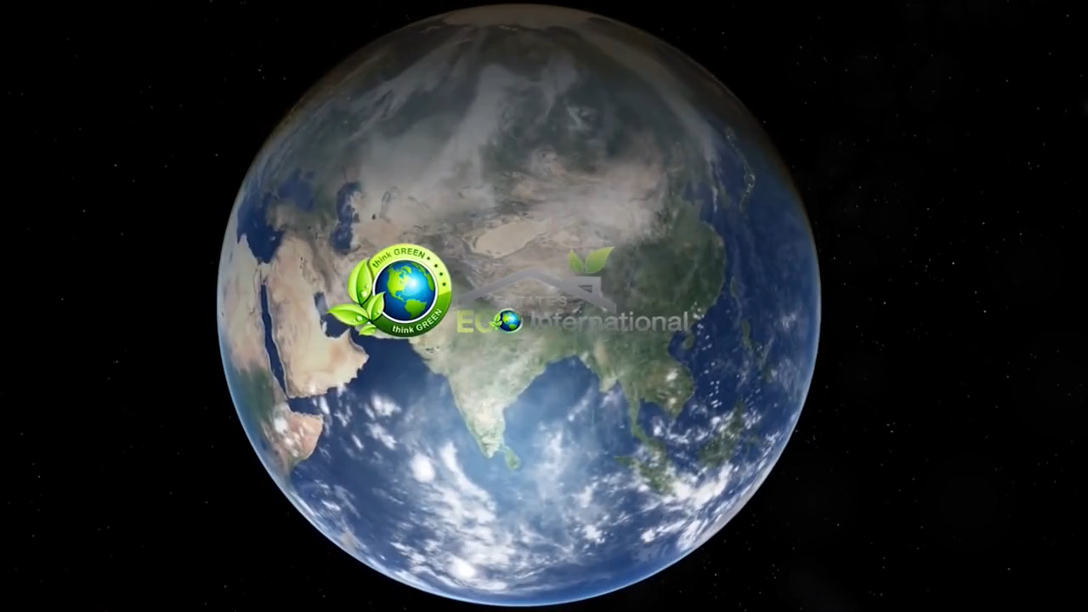

Slide 6
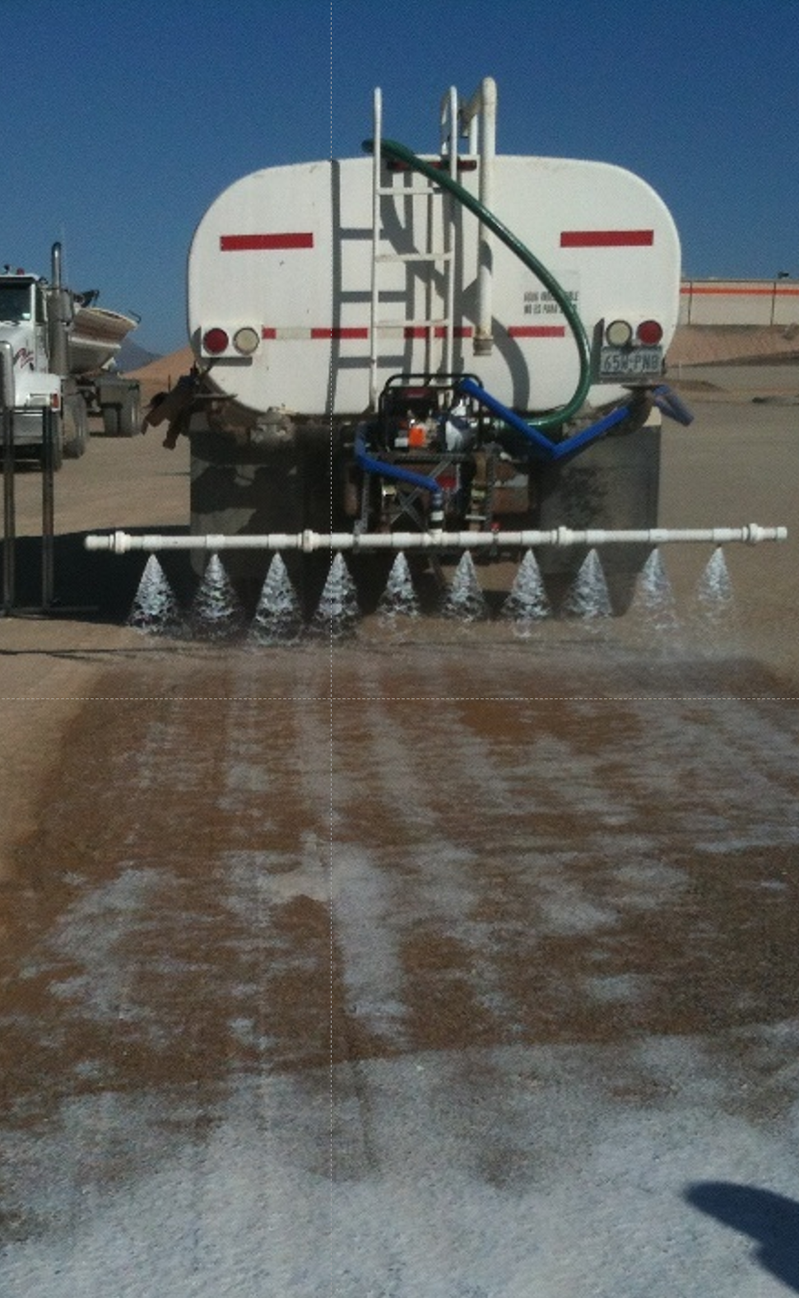
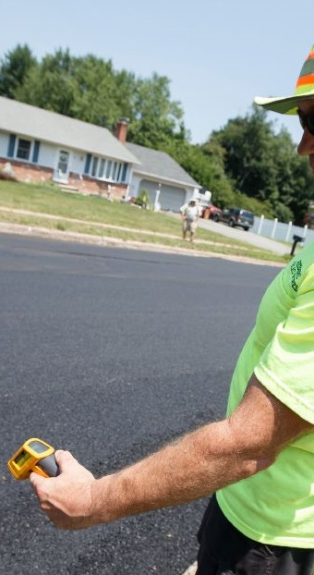
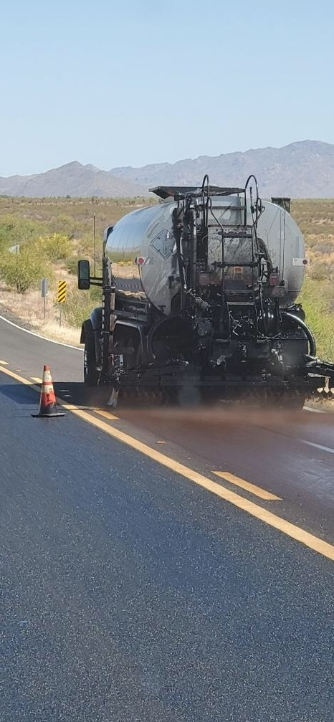
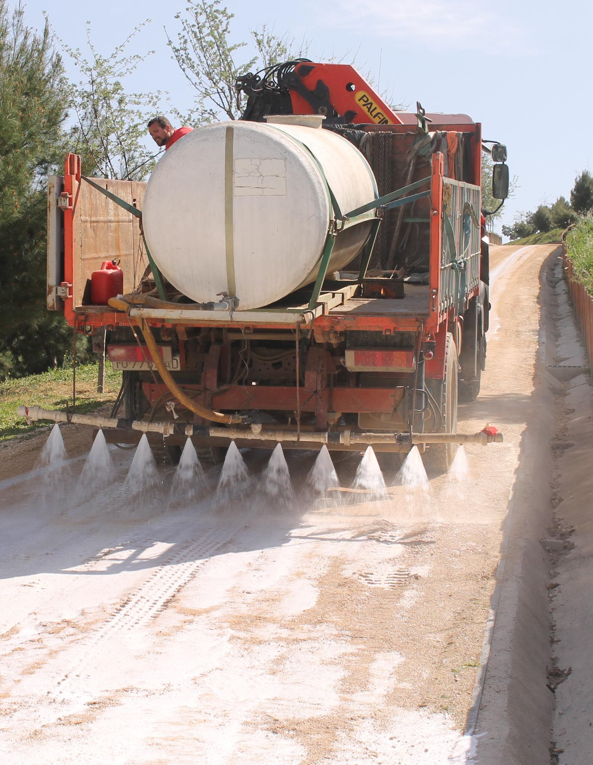
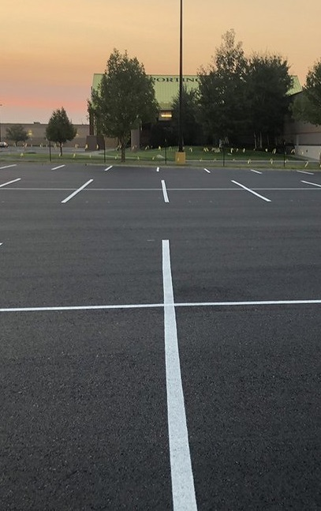
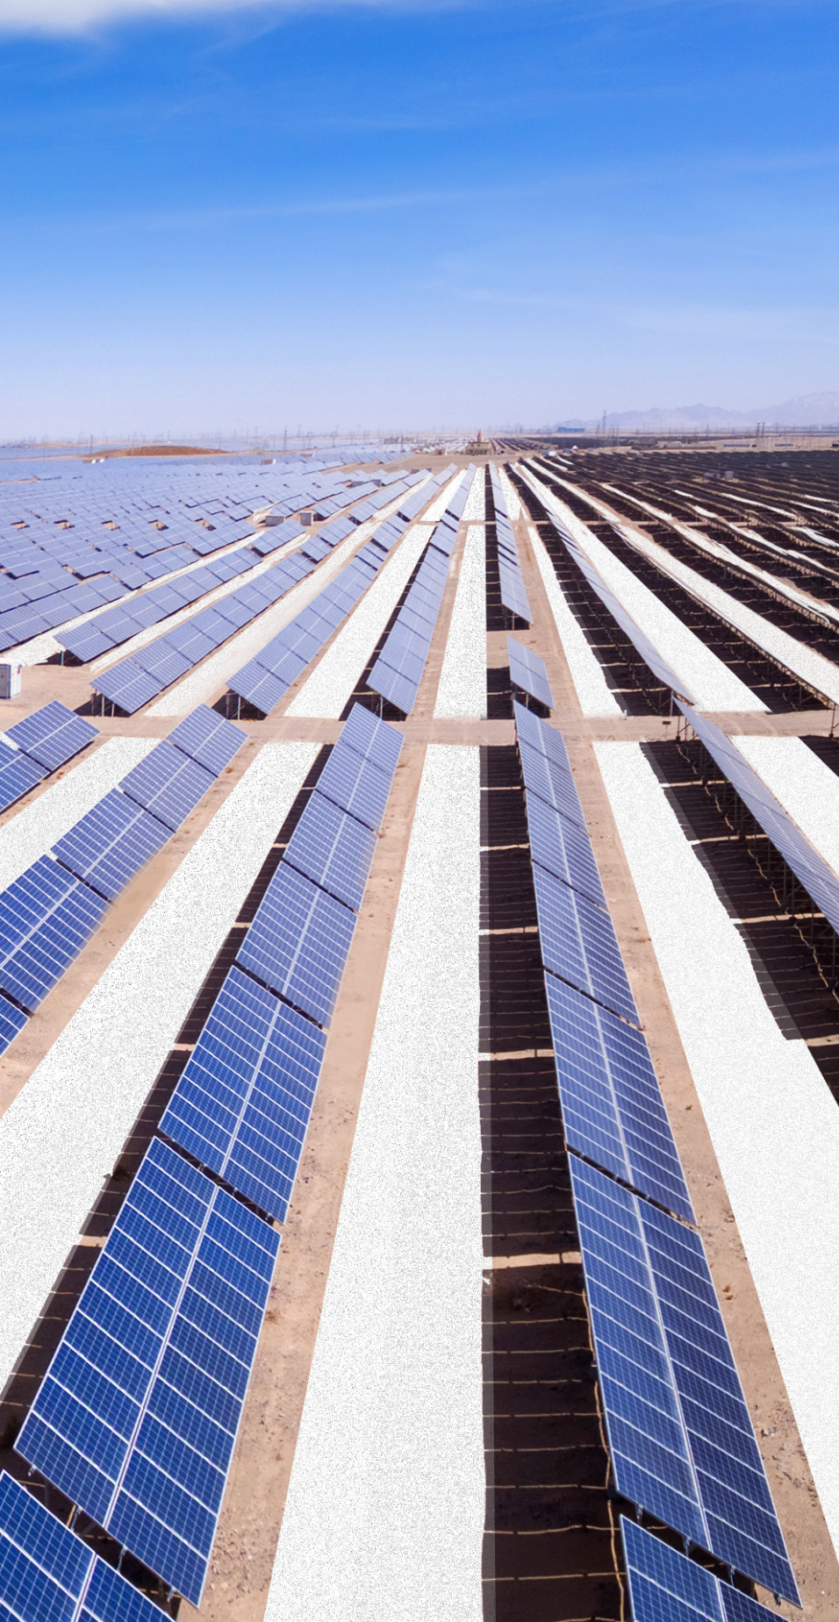
MAXIMIZE ALBEDO PRODUCTION
BI-FACIAL SOLAR FARMS
CONTROL EROSION
DUST, VEGETATION
COOLER >15 F/7 C,
LESS HEAT ABSORPTION
ROAD PAVEMENTS &
PARKING LOTS to MITIGATE URBAN ISLAND HEATING
BUILD NEW ROADS
PAVEMENTS &
PARKING LOTS,
DUST CONTROL
FIX EXISTING ROADS
PAVEMENTS &
PARKING LOTS
Notes:
We can fix current pavements, build new pavements, and lower city temperatures with cooler pavements, increase production of solar farms and reduce operation and maintenance costs significantly. However today I will present 3 materials (2) two to build new roads and (1) on to fix existing asphalt/chip seal roads/parking lots.

Slide 7
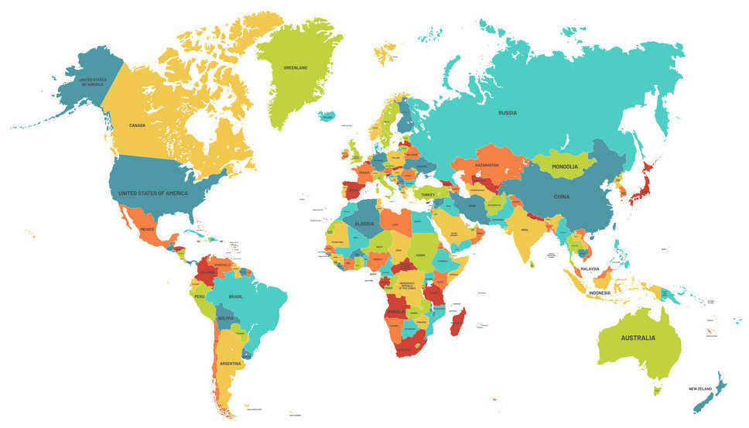
TERRA PAVE PRODUCTS HAVE BEEN USED IN +40 COUNTRIES
Notes:
QUESTION so FAR?

Slide 8
AWARDS and NOMINATION
TERRA PAVE received the following Recognition and Awards:
2019: Awarded top 10 products in the USA by the Department of Energy's National Renewable Energy Laboratory in Colorado Springs Colorado.
2021: Awarded top 10 products in the world at the Web Summit in Lisbon, Portugal.
2023: Received the #1 award in the Environmental and Agriculture category in the USA from the Cade Prize in Gainesville Florida.
2024: Nominated for the BIO-Circular-Green Award by the U.S. Department of State at the Asia-Pacific Economic Cooperation in Bangkok, Thailand.

Slide 9
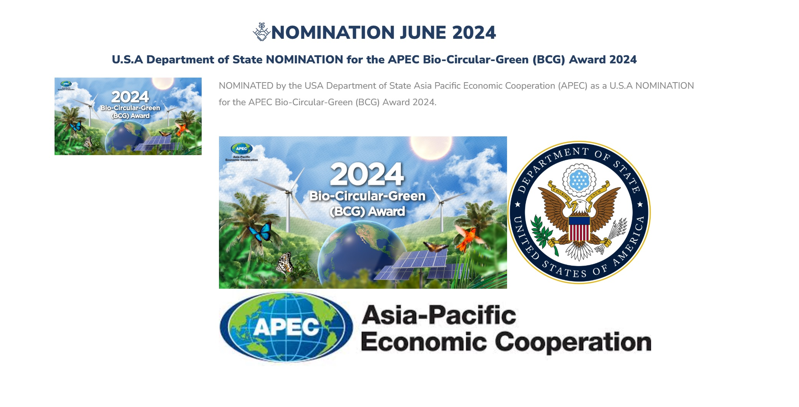
USA STATE DEPARTMENT NOMINATION –
APEC Bio-Circular-Green (BCG) Award – June 2024

Slide 10




USA CADE PRIZE –
AWARD 1st place AG & ENVIRONMENTAL 2023
TOP 1 Eco-Friendly Product in USA 2023

Slide 11

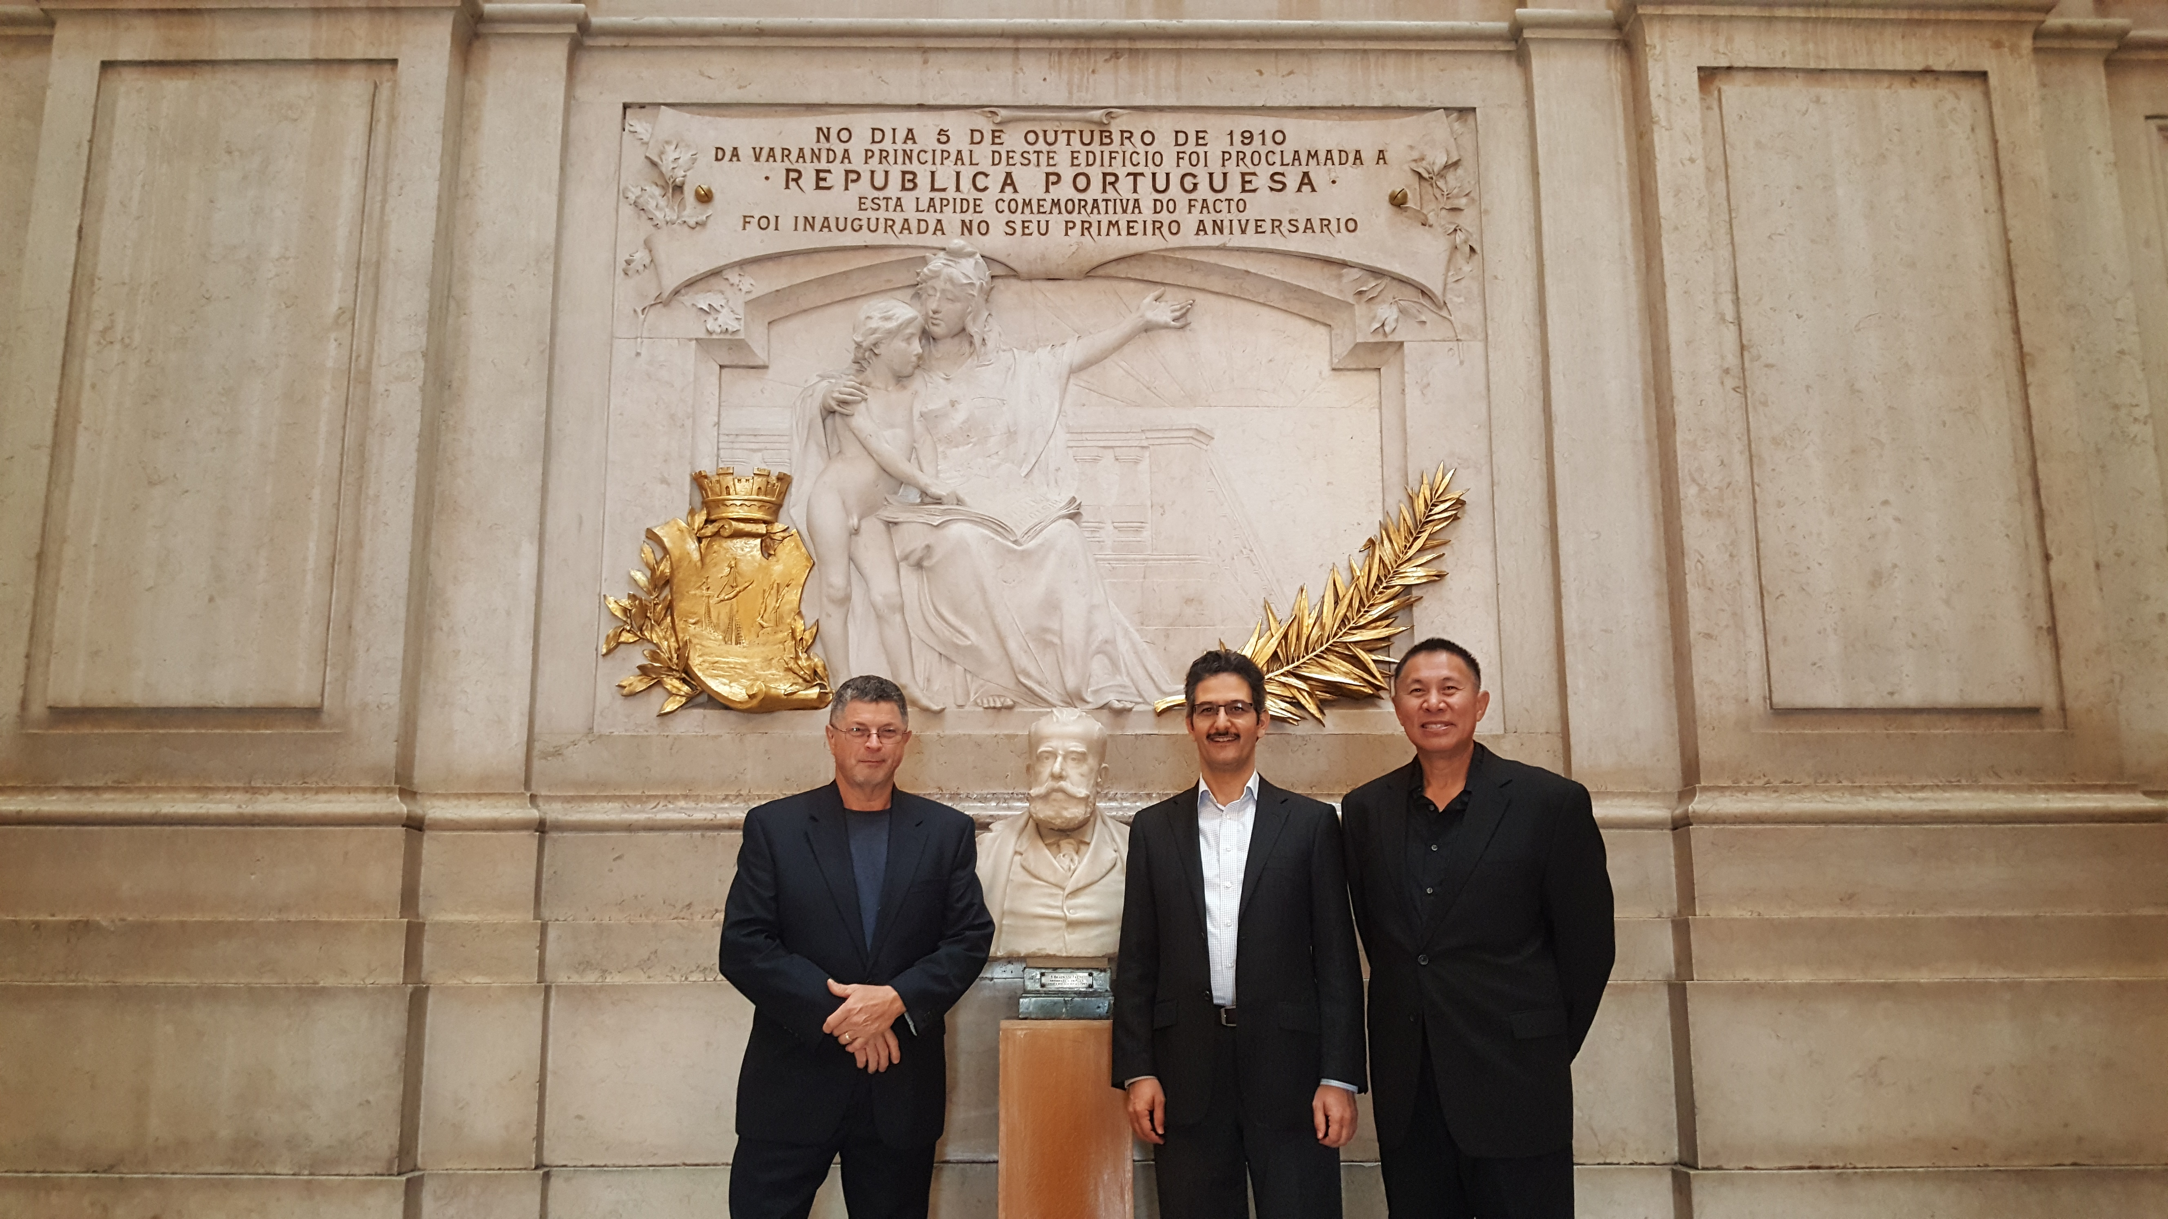
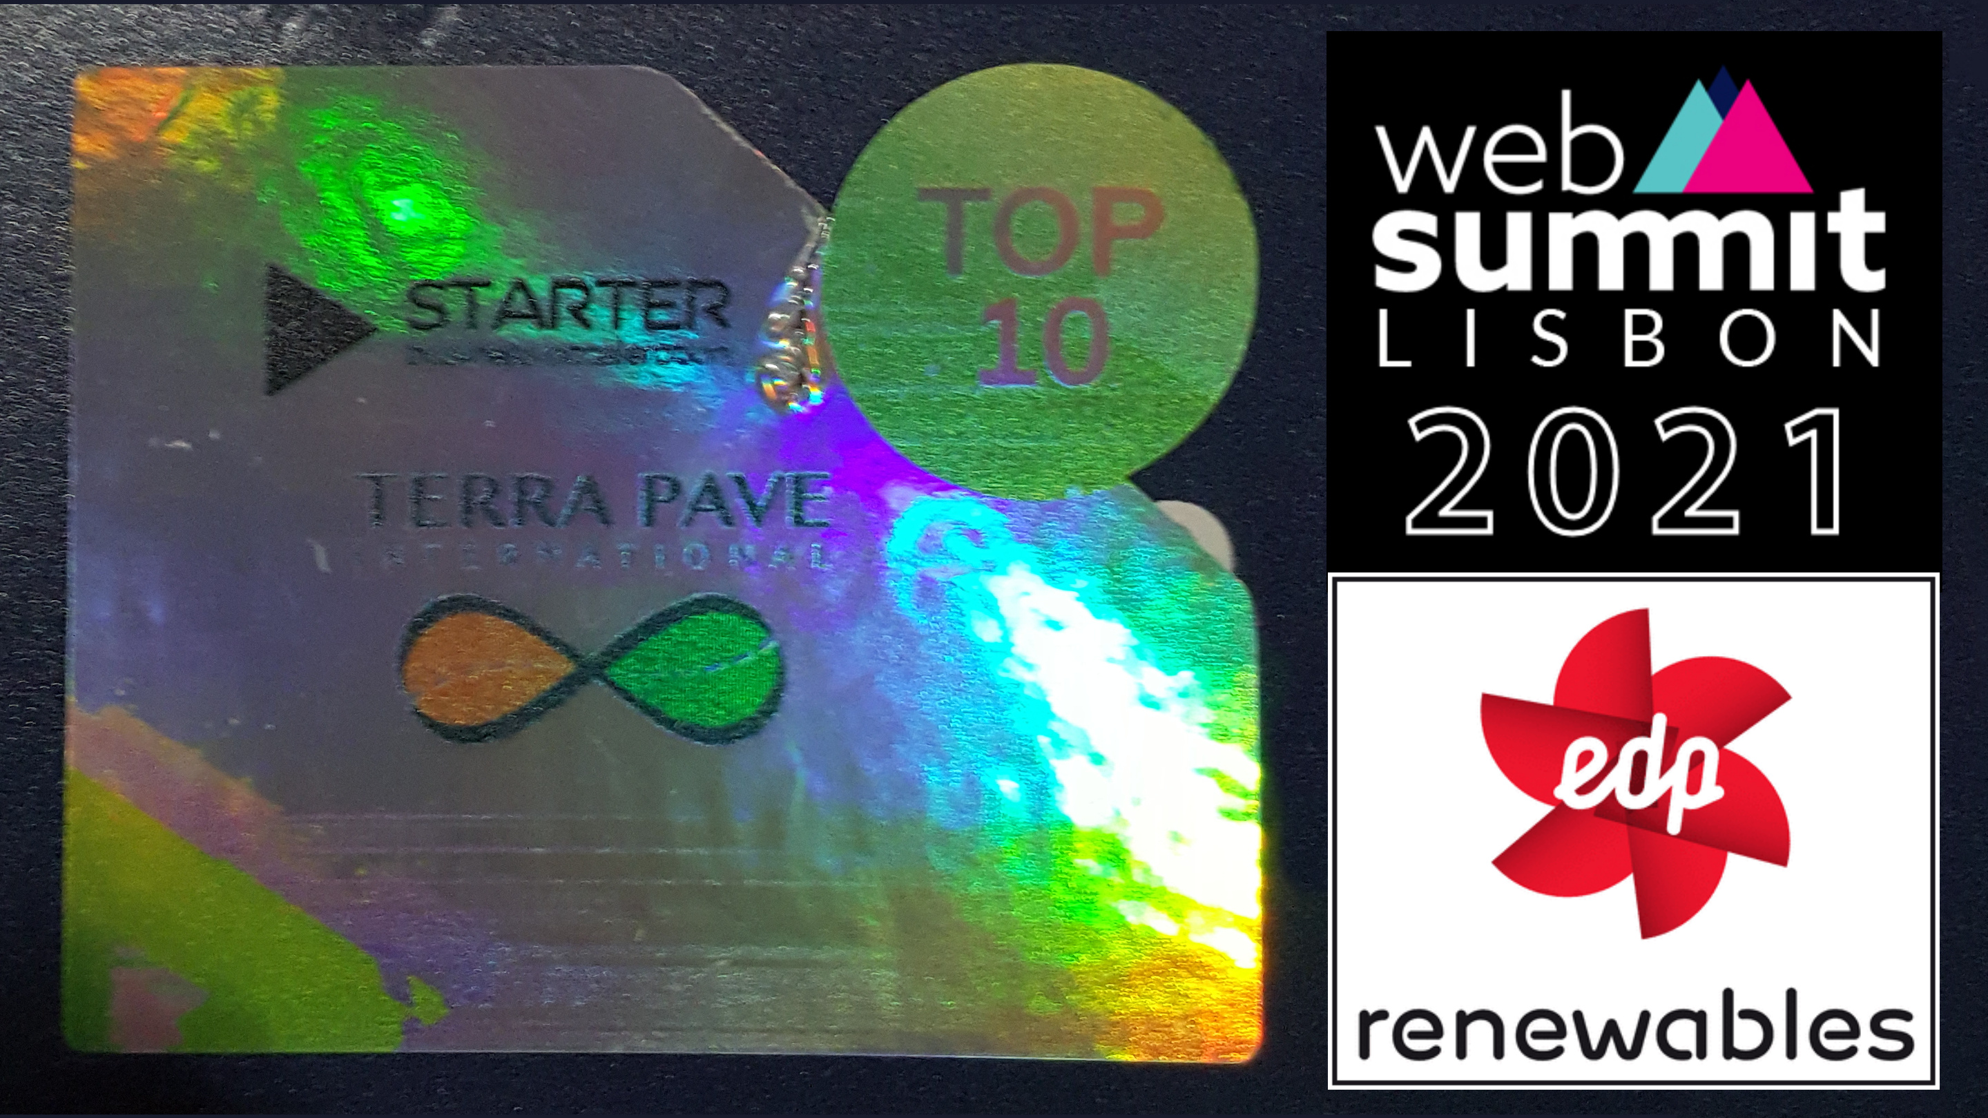

WEBSUMMIT LISBON, PORTUGAL
November 2021 – TOP 10 WORLD WINNER
TOP 10 Eco-Friendly Products in the WORLD November 2021
Web Summit Lisbon, Portugal

Slide 12
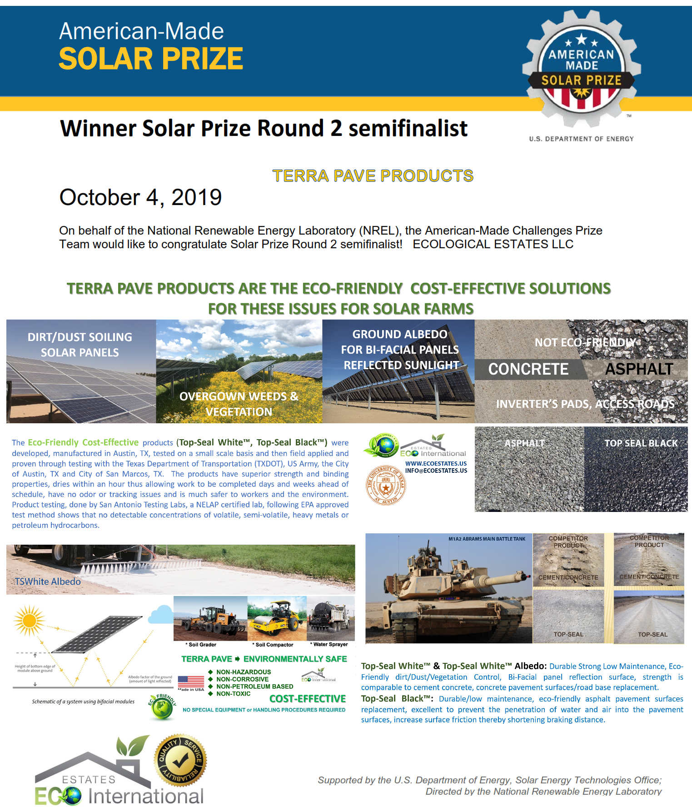
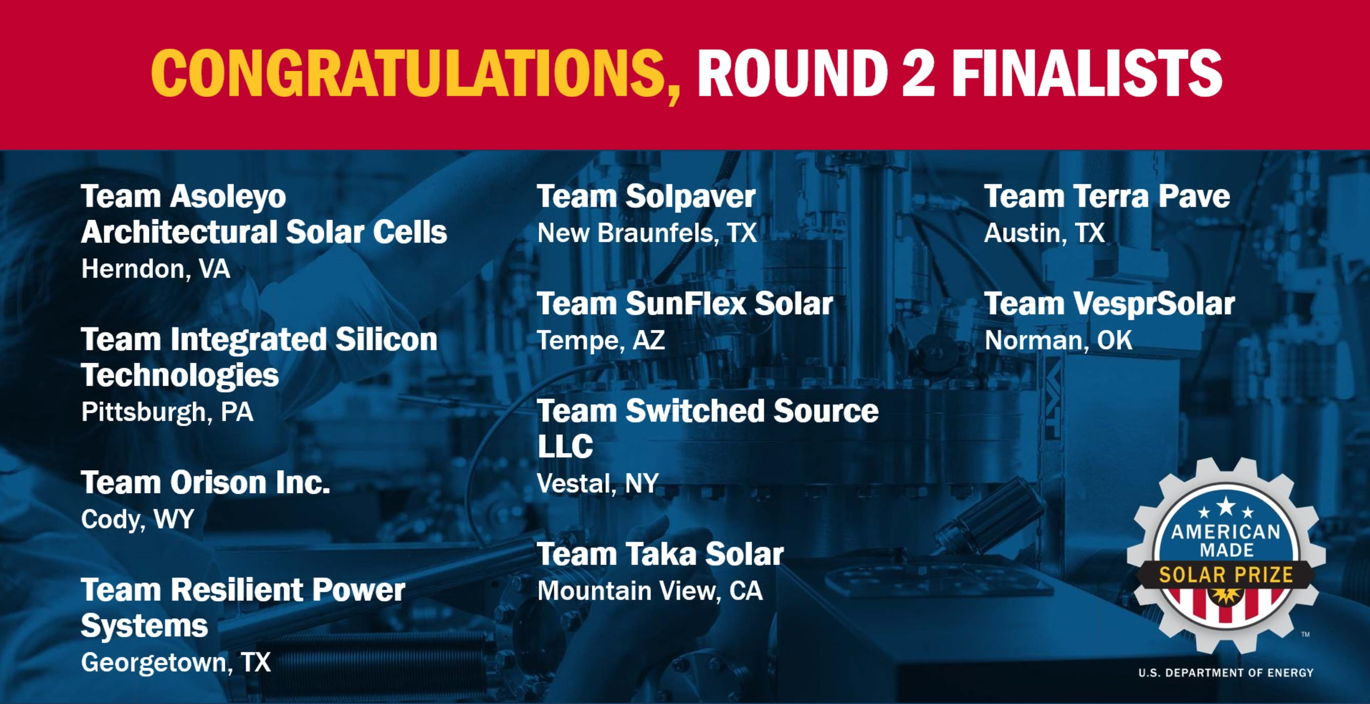

NREL USA Department of Energy –
AWARD top 10 2019-2020
TOP 10 Eco-Friendly Products 2019-2020
National Renewable Energy Lab
USA Department of Energy

Slide 13
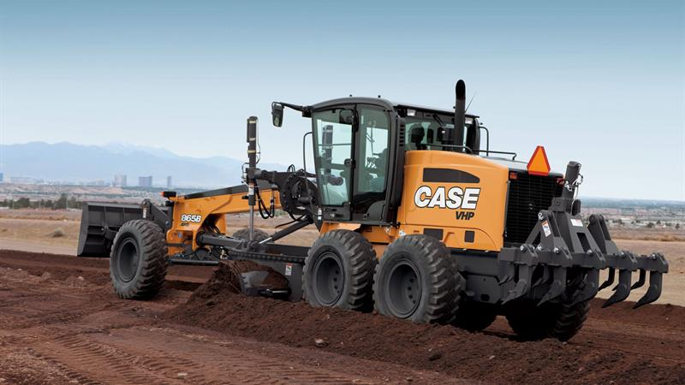
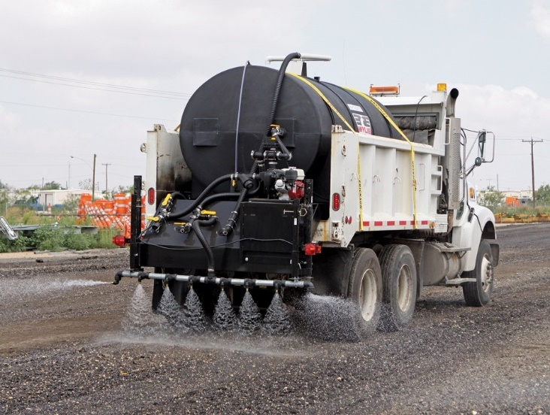
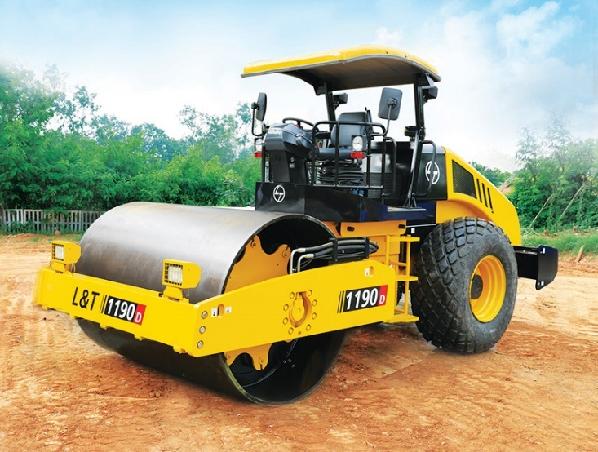
SUPERIOR QUALITY, FAST TO TRAFFIC ABLE, MINIMAL EQUIPMENT & GREEN
* Soil Grader * Water Sprayer * Soil Compactor
NO SPECIAL EQUIPMENT & NO HANDLING PROCEDURES REQUIRED
TERRA PAVE ENVIRONMENTALLY SAFE
NON-HAZARDOUS
NON-CORROSIVE
NON-PETROLEUM BASED
NON-TOXIC
WATERPROOF
SUPERIOR TO TOXIC ASPHALT AND CLIMATE-WRECKING CEMENT
NO MORE POTHOLES, CRACKS
IMPROVED BRAKING DISTANCE
FAST TO TRAFFIC ABLE
LESS DOWNTIME
MORE ENJOYABLE RIDE
More details of ECO-FRIENDLY test results can be downloaded: https://www.terrapavetech.com/terrapave/sandia.pdf
Notes:
So EASY and FAST to apply with no special equipment and no handling procedure required - 100% environmentally safe

Slide 14
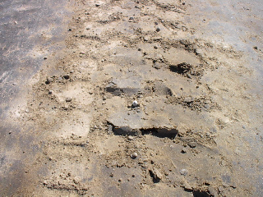
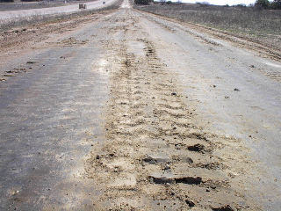
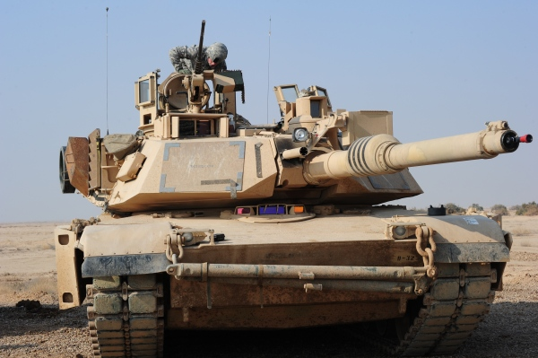
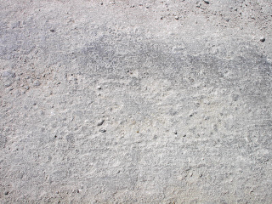
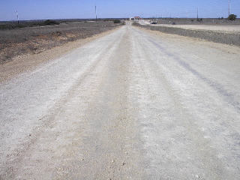
BATTLE TESTED – USA MILITARY ROADS - TERRA PAVE WHITE
abram tankS
M1-a2 MAIN BATTLE TANKS
COMPETITOR PRODUCT
COMPETITOR PRODUCT
TERRA PAVE WHITE
TERRA PAVE WHITE
Notes:
1st product New Road Construction - TERRA PAVE WHITE - Terra Pave has been battle tested – competitor pictures on top petroleum based materials – below Terra Pave White

Slide 15
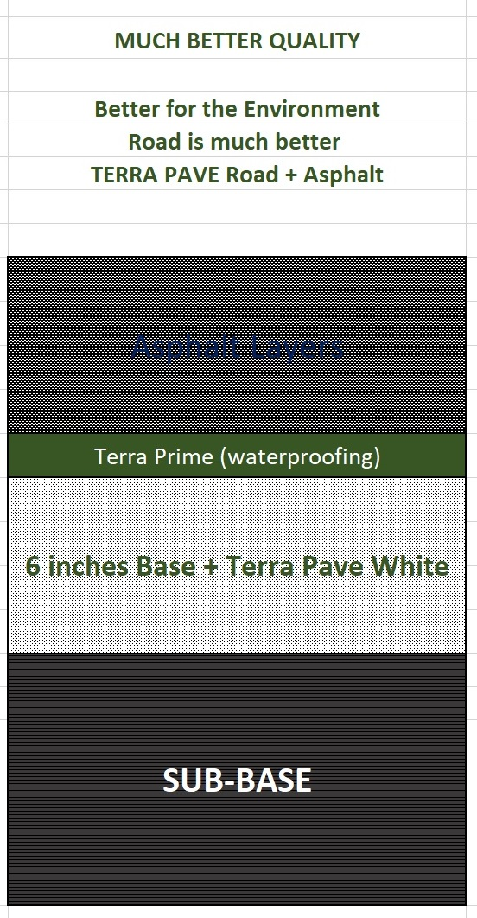




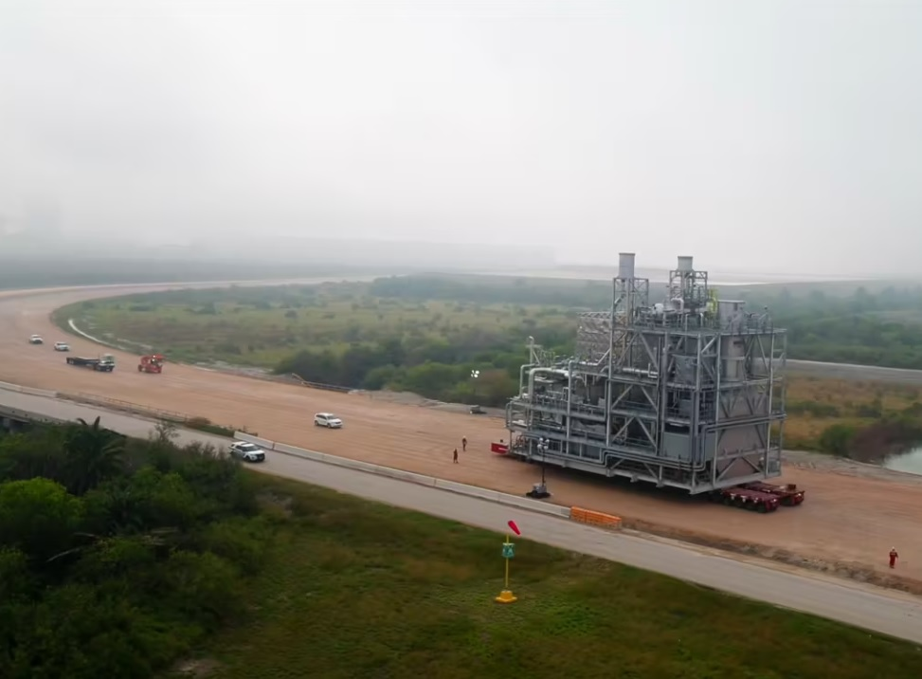
No-Asphalt TERRA PAVE WHITE Roads
Country of CHILE
South America
Terra Pave White Road Project
TPW: 0.5 gal/square yard
2.27 liters/square meter
15 cm Base + TP White
https://youtu.be/yYqVTOmPjgs
EXXON-MOBIL
Texas
Terra Pave White Road Project
TPW: 0.5 gal/square yard
2.27 liters/square meter
https://www.terrapavetech.com/videos/tpwexxon.mp4
https://vimeo.com/377598222

Slide 16
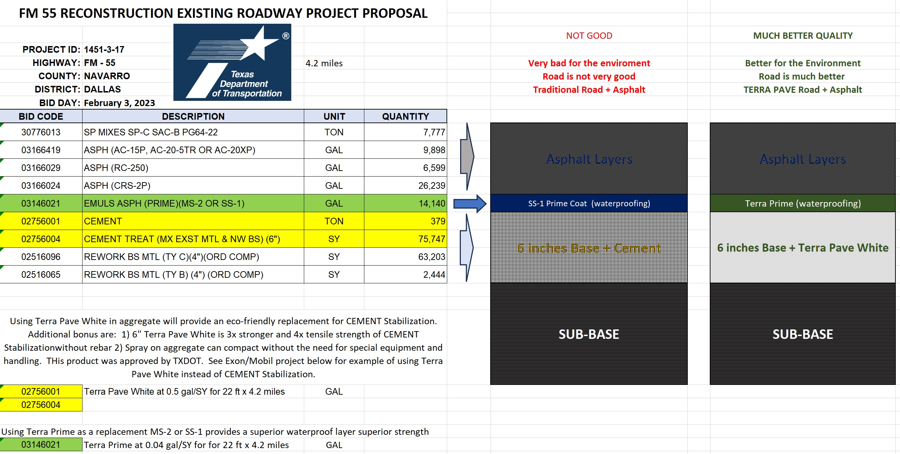
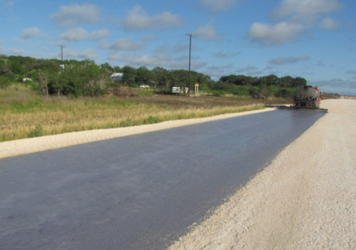
TERRA PRIME (New road)
15 cm Base + Cement
15 cm Base + TP White
Superior Quality, Waterproof Strong Base Layer, Fast to Traffic Able, Lower Cost, More Eco-Friendly
Notes:
2nd New product for new road construction – Terra Prime, SEAL PRIME LAYER

Slide 17
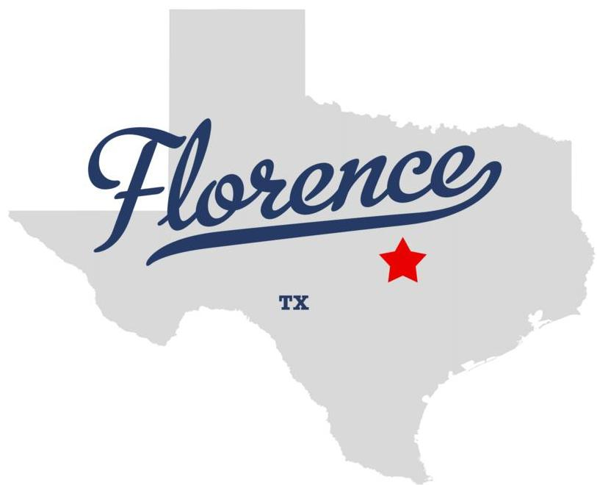


15 cm Base + TP White
Florence, Texas USA
TXDoT
https://youtu.be/_i-Z5qdsl90
Notes:
Texas Department of Transportation largest in the USA. One of the largest in the world.

Slide 18
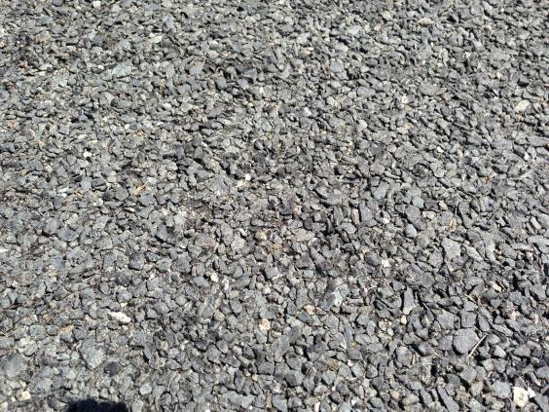
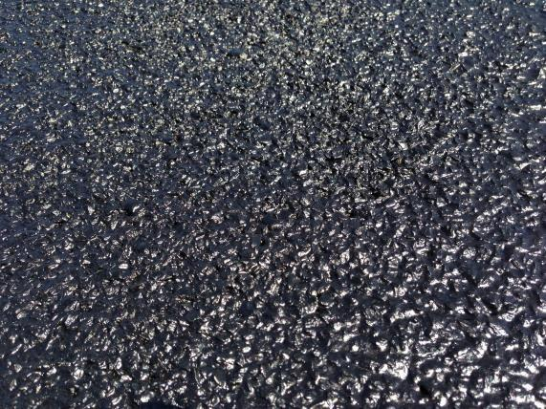
TERRA FOG (road MAINTENANCE)
Before Application with Terra Fog ™
After Application with Terra Fog ™
Terra Fog is a high-quality, environment-friendly, and cost-effective solution for improving performance and extending service life in chip seals, and asphalt pavements.

Slide 19
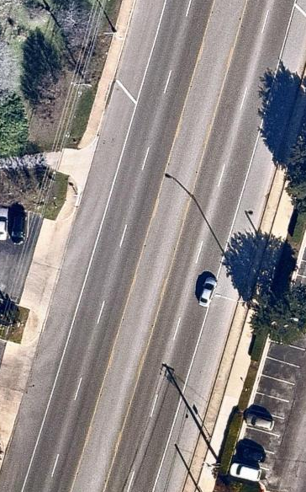
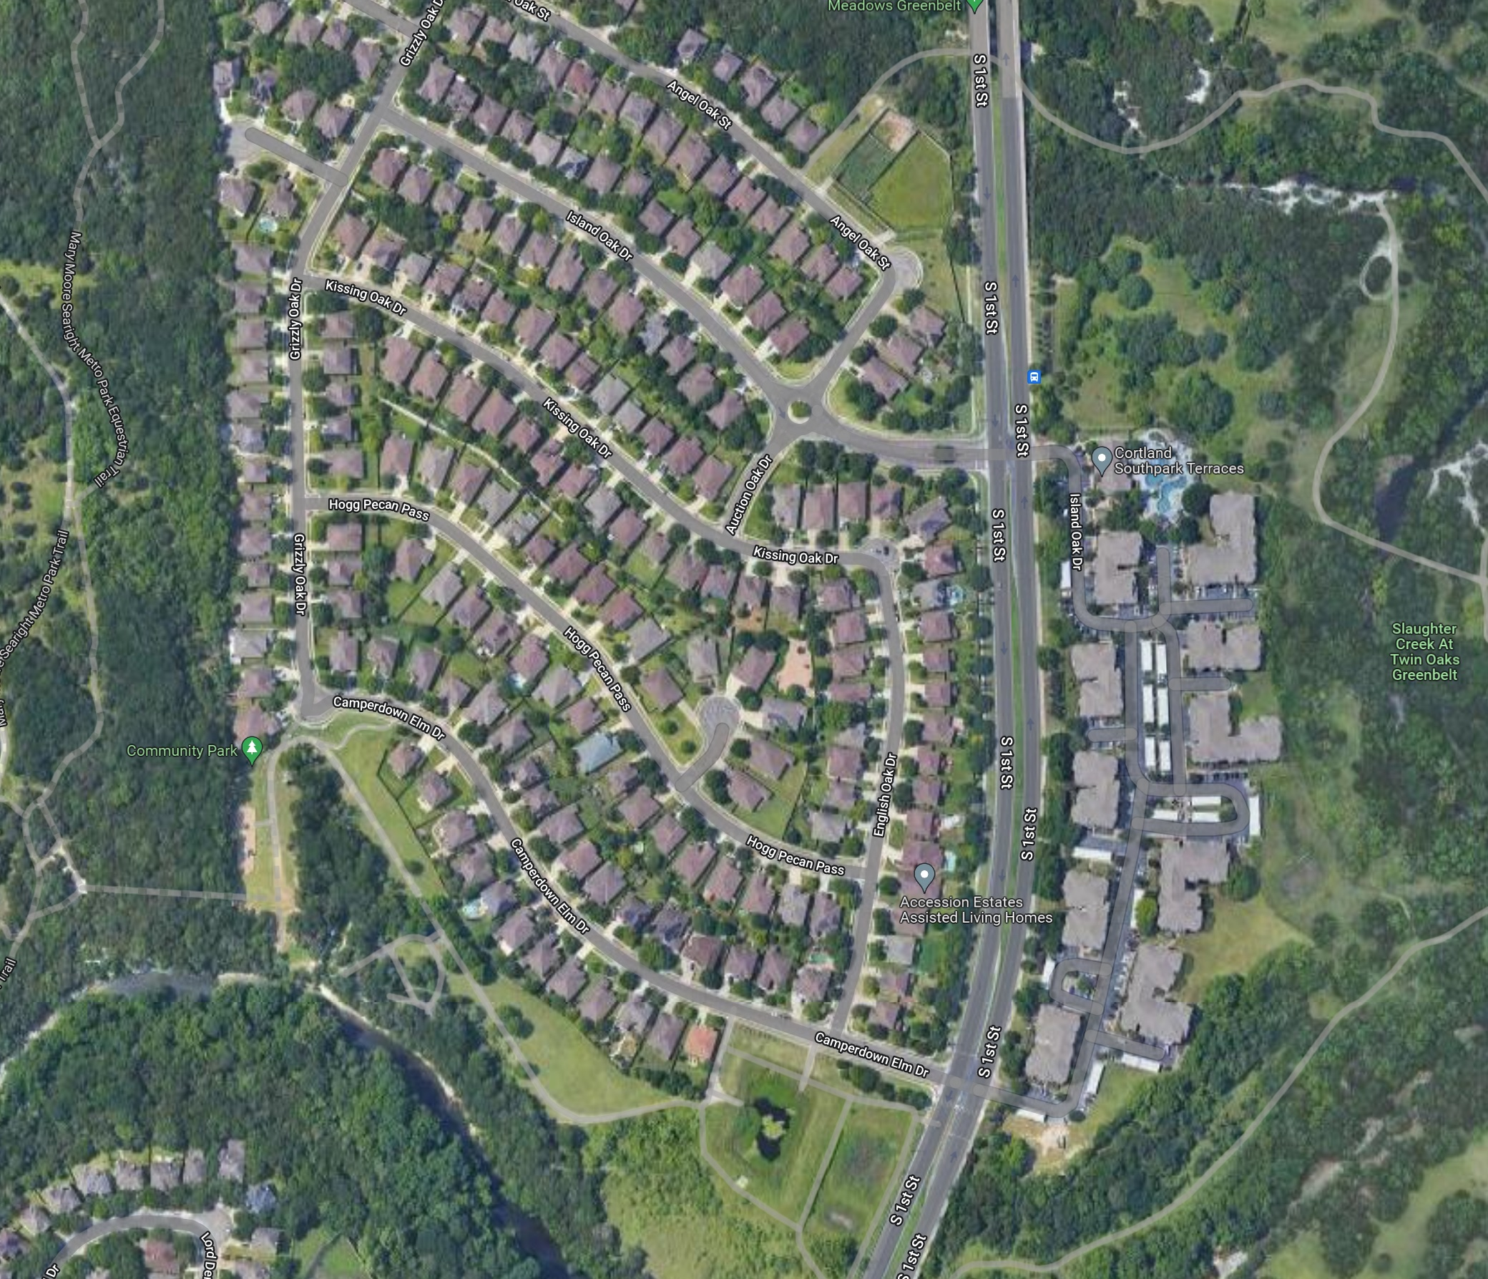

City of Austin - Terra Fog™ (TF) Project Video – Road Maintenance (TF: 0.04 gal/square yard)
https://youtu.be/XJTlFs-v92I
Notes:
Road maintenance and preservation, City of Austin, TEXAS – fast, durable extend the life of the road 2-3x.

Slide 20
TERRA FOG – Fog Seal
Non-toxic (no acrid smell)
Applied with water truck (reduced labor for clean up)
Dry time is 20 min ~ 30 min
Pull-off strength of aggregate is substantially increased.
Reduced rollover and Eliminated embedded rock loss.
0.04 gal/sqyd residual rate recommended
Calhoun County Texas
Terra Fog Application
Notes:
This video in Calhoun County, TEXAS – show the easy application of TERRA FOG

Slide 21

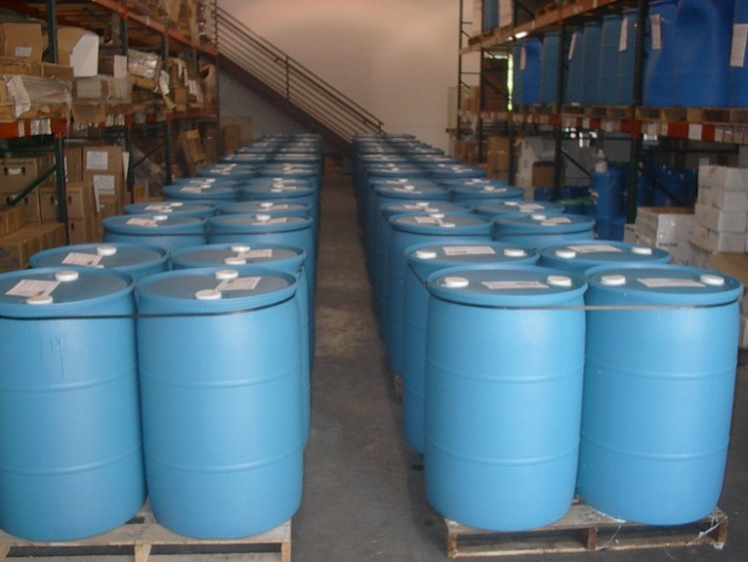
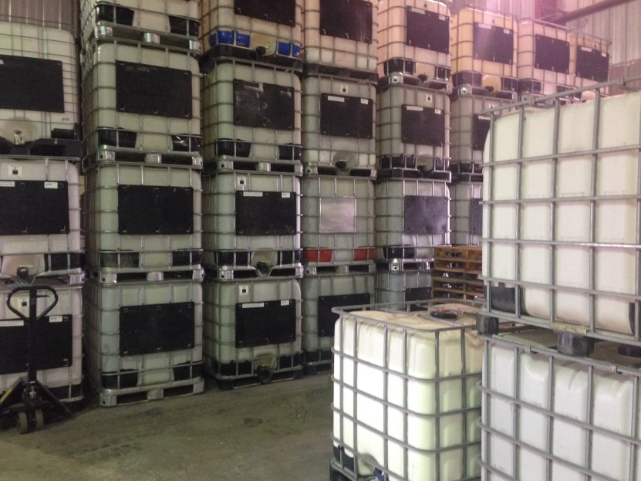
PACKAGING-SHIPPING
TP products
55 gallon (208 liter) drums
275 gallon (1,040 liter) totes
Shipping category same as WATER
Notes:
TP is ship in 55 gal drum or 275 gal tote Made in Texas

Slide 22
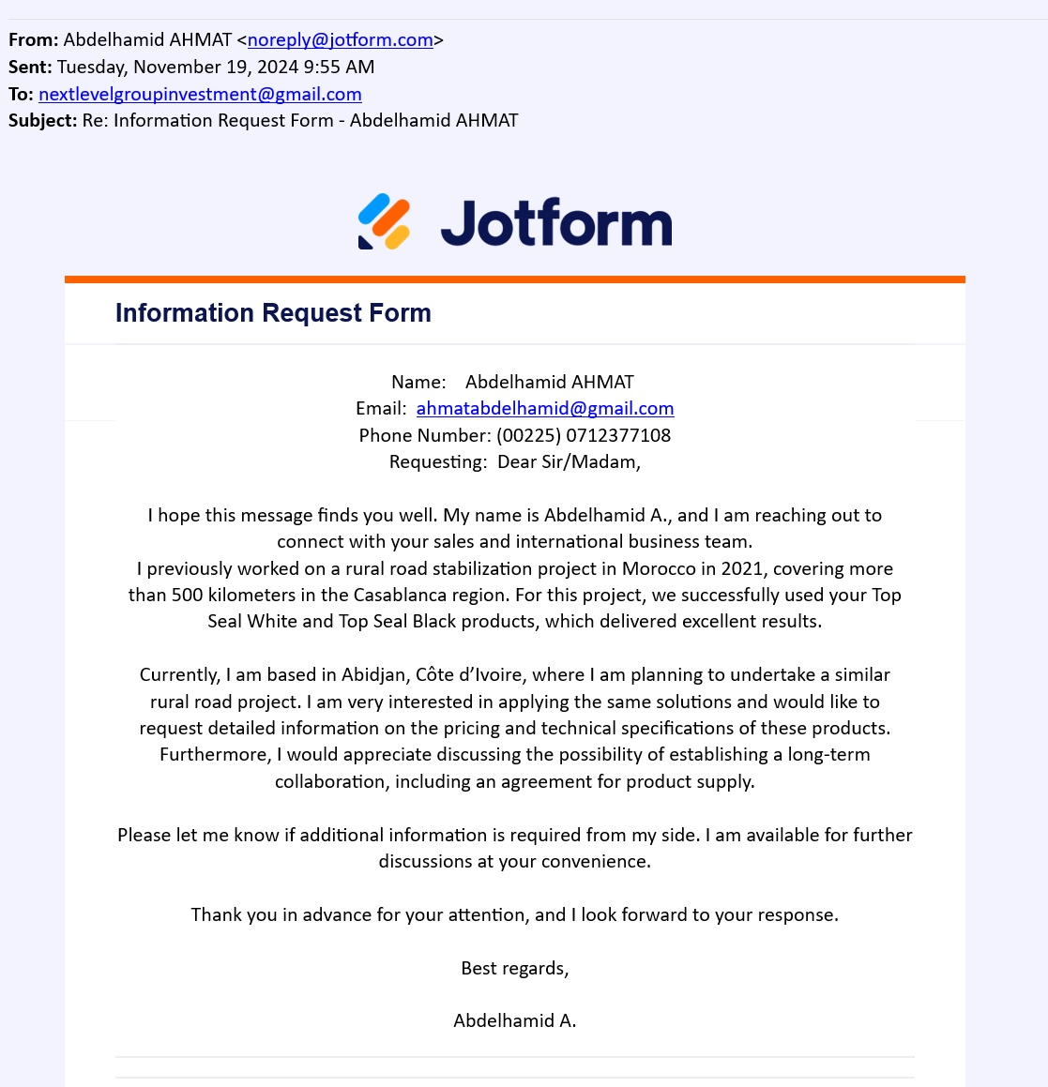




Notes:
That is why OUR TEAM invented Terra Pave

Slide 23

ECOLOGICAL ESTATES LLC. / EEI Holding
P.O.Box 171214
Austin, Texas USA
UTA-TERRA PAVE INTERNATIONAL, Inc.
Austin, Texas USA
Email: info@terrapavetech.com
Web: www.ecoestates.us www.terrapavetech.com
Notes:
We Thank you so much for the opportunity. I will show some pictures

Slide 24
ECOLOGICAL ESTATES LLC. / EEI Holding
P.O.Box 171214
Austin, Texas USA
UTA-TERRA PAVE INTERNATIONAL, Inc.
West Pickle Research Center
UT at Austin
Austin, Texas USA
Email: info@terrapavetech.com
Web: www.terrapavetech.com
Notes:
We Thank you so much for the opportunity. I will show some pictures

Slide 25
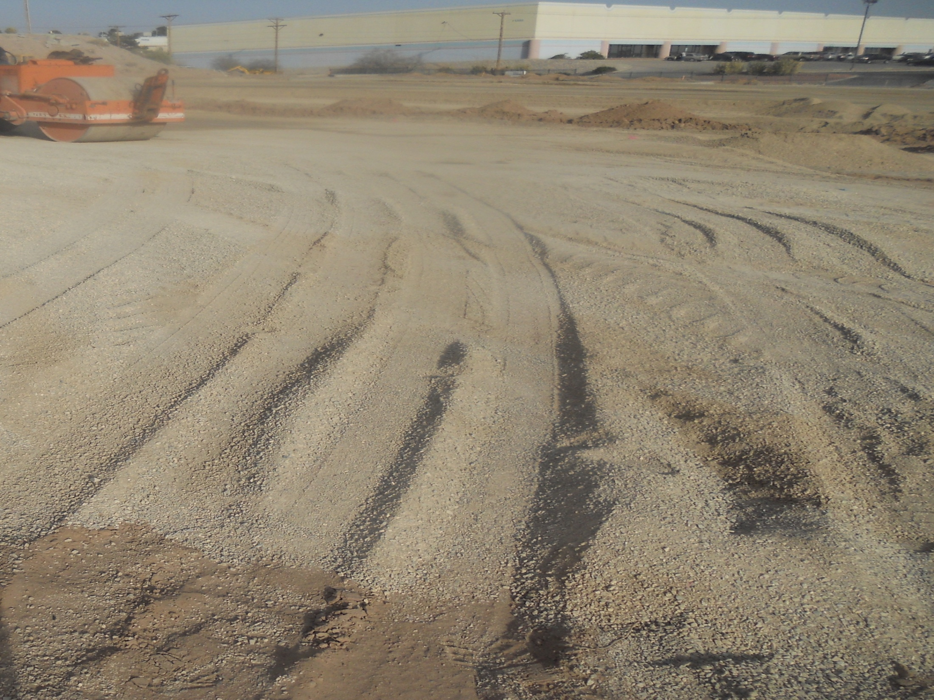
Loose soil prepared for application of TSW
Notes:
Loose soil prepared for application of TSW

Slide 26
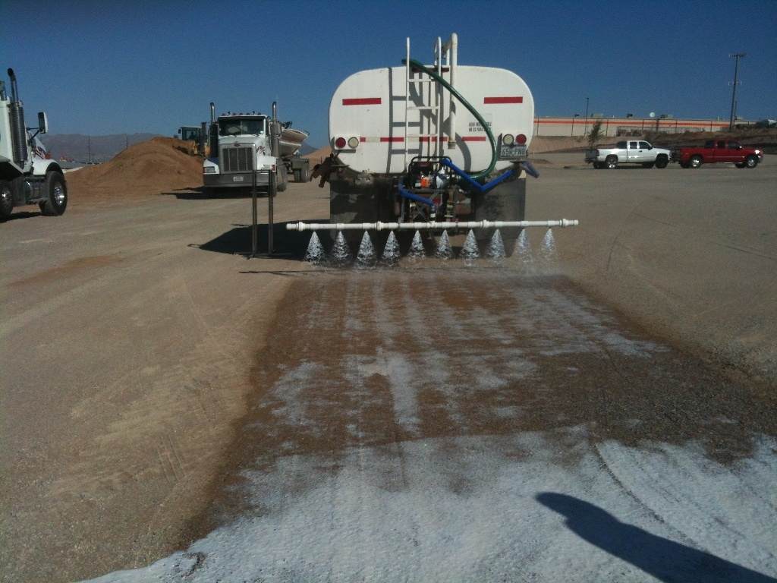
Application of Top-Seal White
Notes:
Application of Terra Pave White

Slide 27
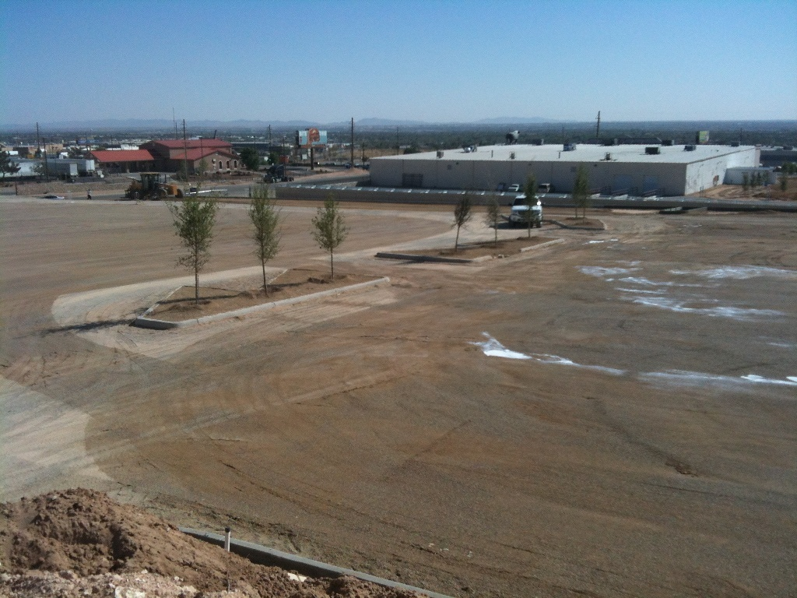
Top-Seal White soaking into the soil into the base
Notes:
Top-Seal White soaking into the soil in the 2nd section

Slide 28
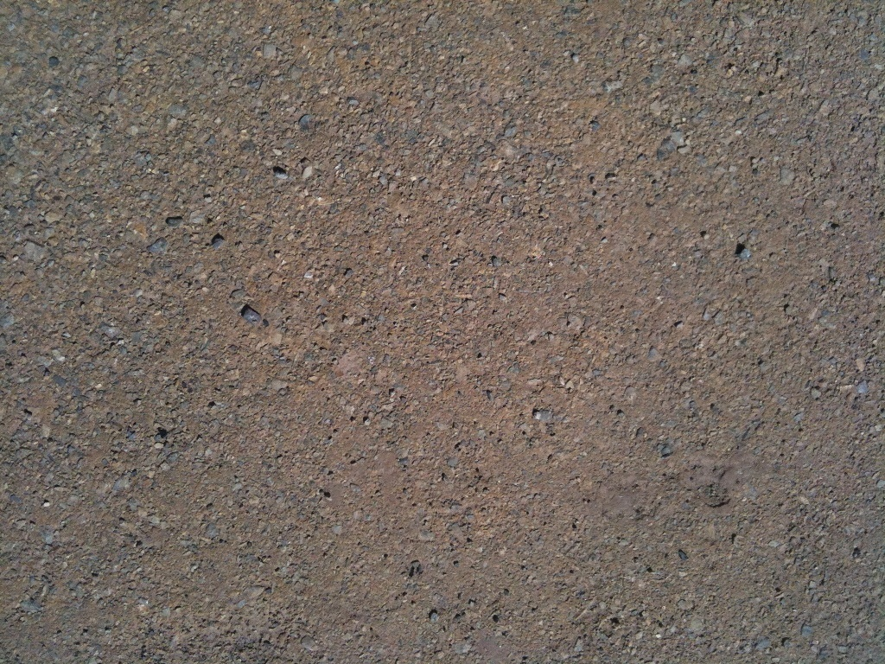
Top-Seal White after 24 hours of curing – close up
Notes:
After 24 hours of curing – close up

Slide 29
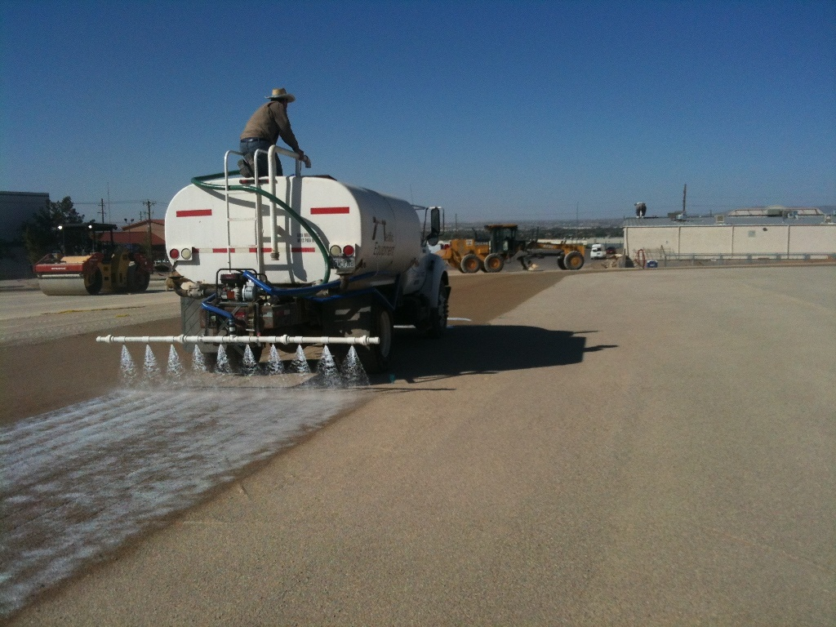
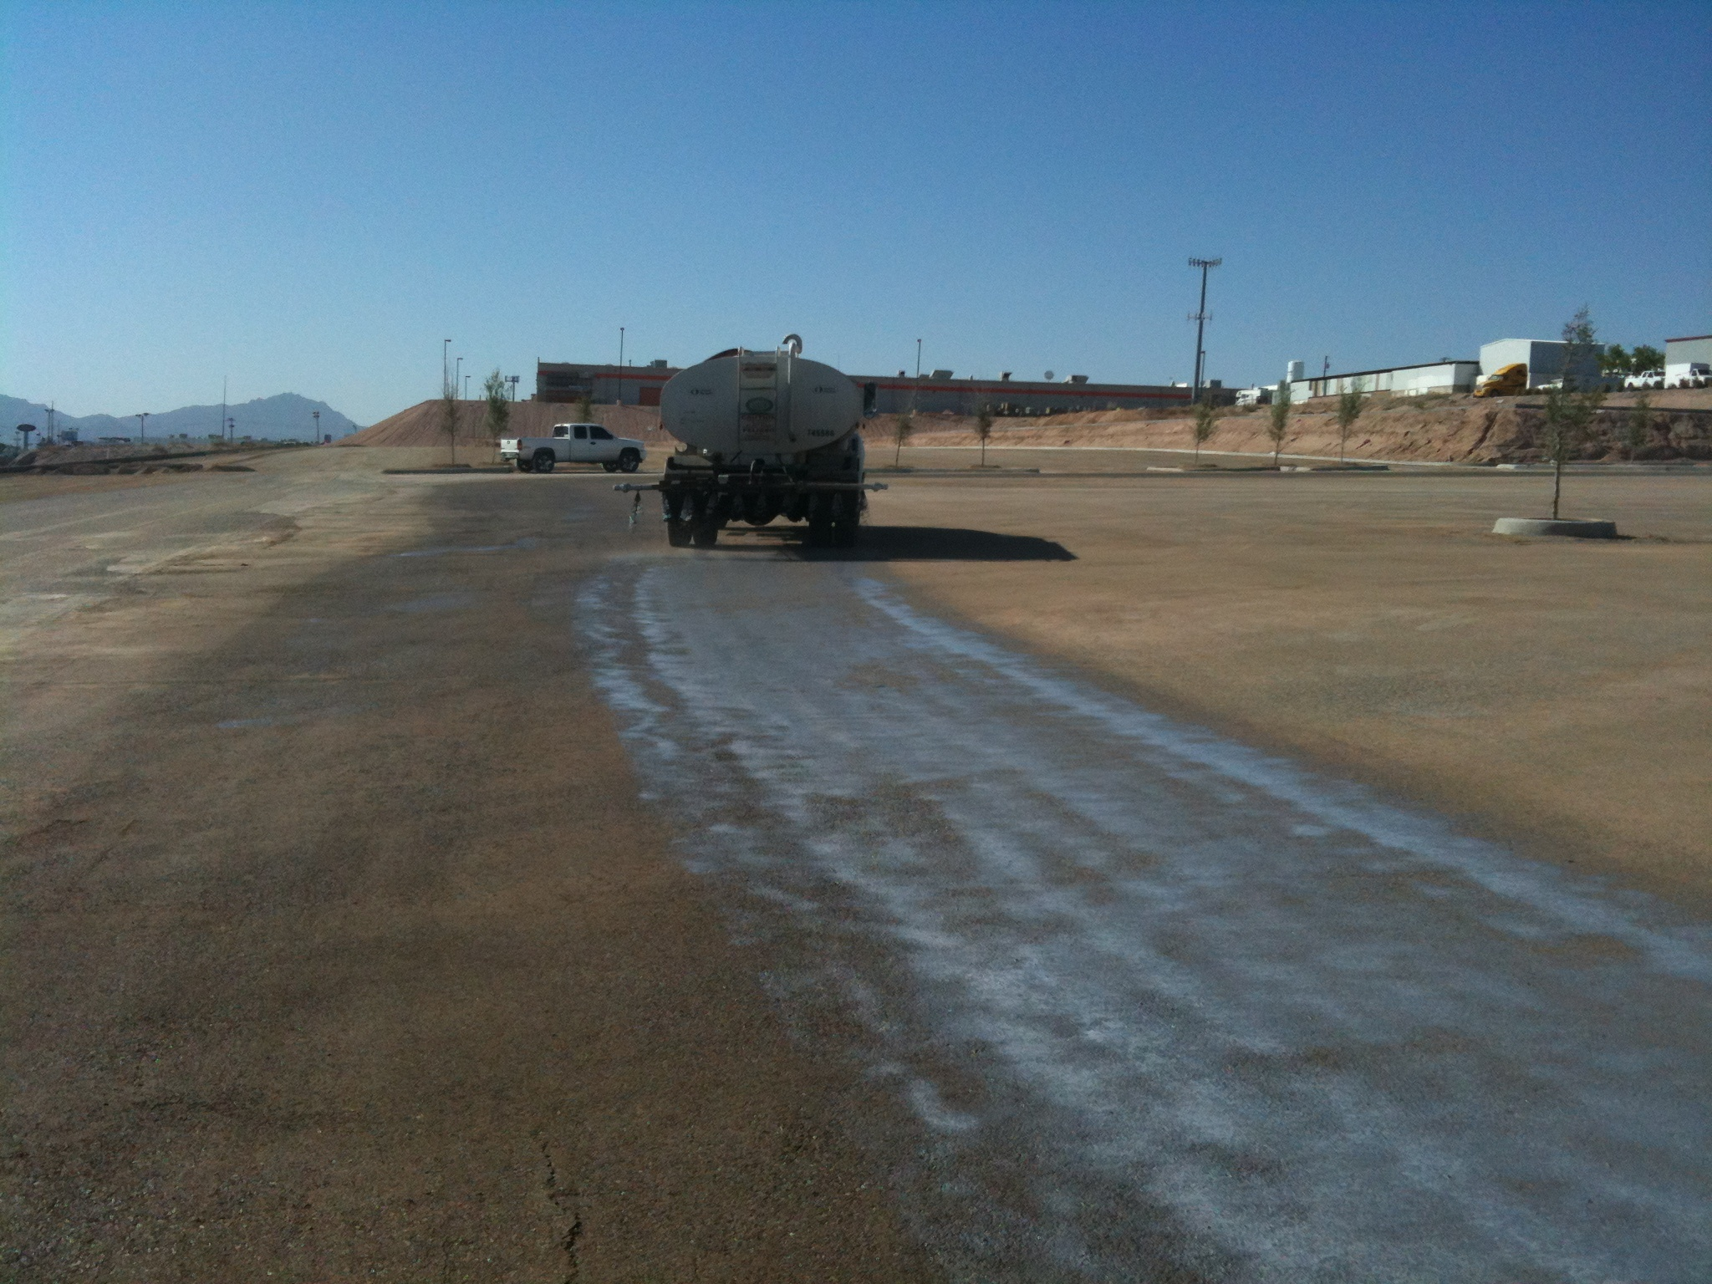
First application of Top-Seal Black
Notes:
Application of Top-Seal Black

Slide 30
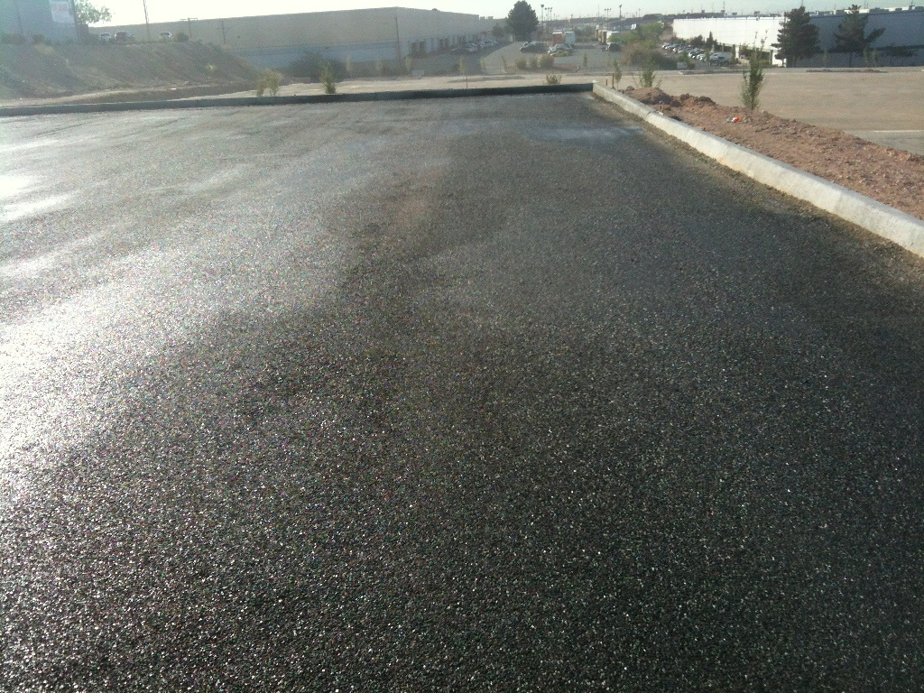
Final application of Top-Seal Black
Notes:
Final application of Top-Seal Black completed

Slide 31
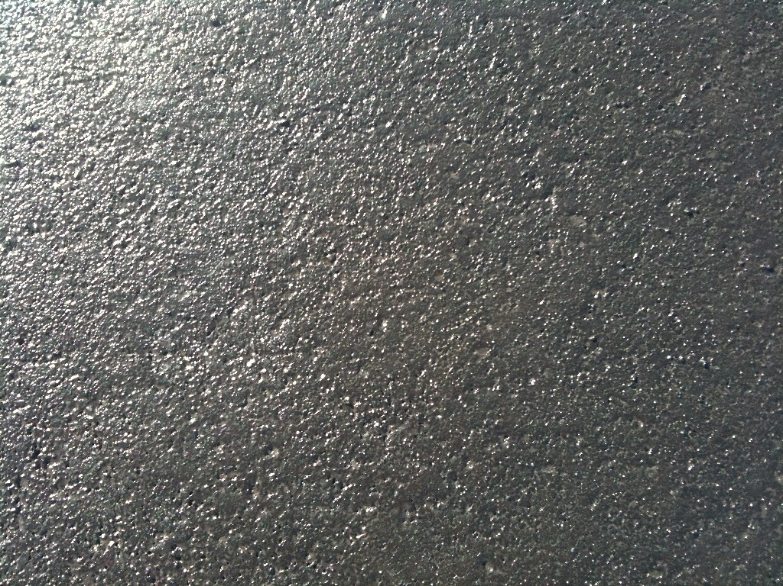
Top-Seal Black – close up after 48 hours
Copyright © 2011 Terra Pave International, Inc. All rights reserved
Notes:
Top-Seal Black – close up after 48 hours and pavement is ready for Vehicles FAST and EASY 100% eco-friendly

Slide 32
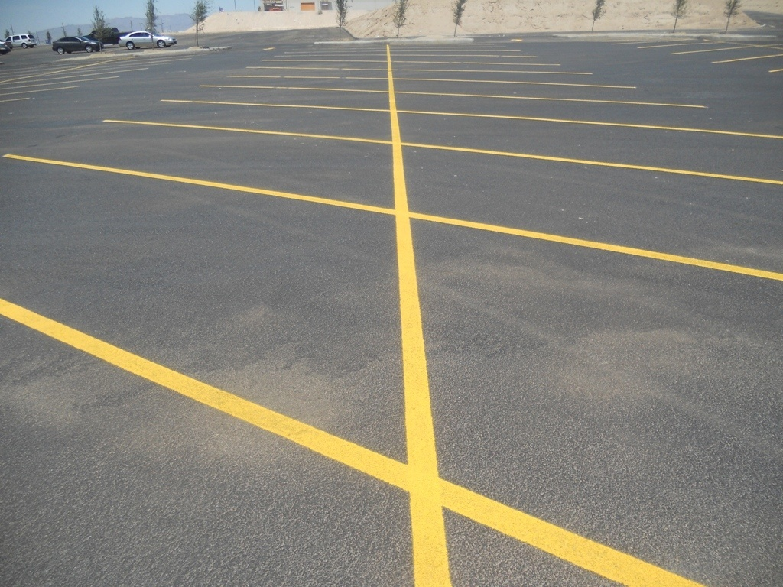
Top-Seal Black – one month later
Notes:
Top-Seal Black – one month later

Slide 33
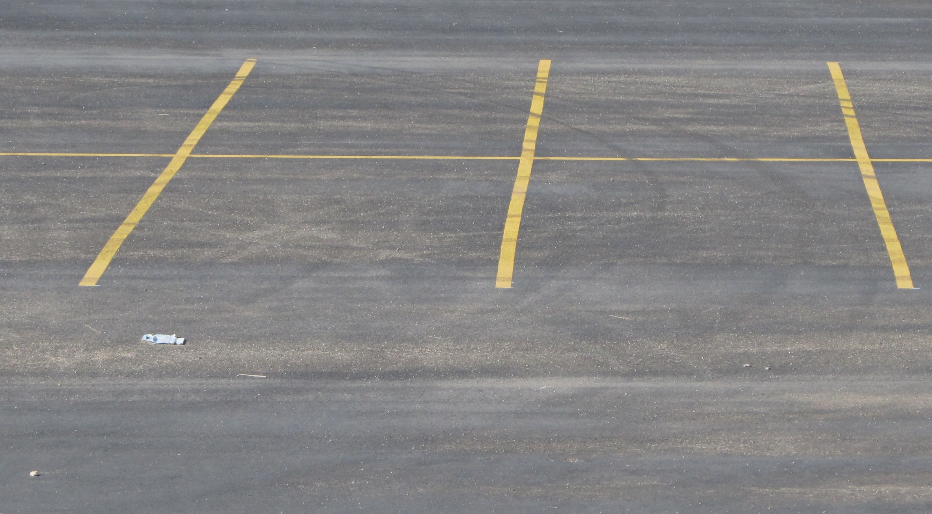
Top-Seal Black – Two Years later

Slide 34
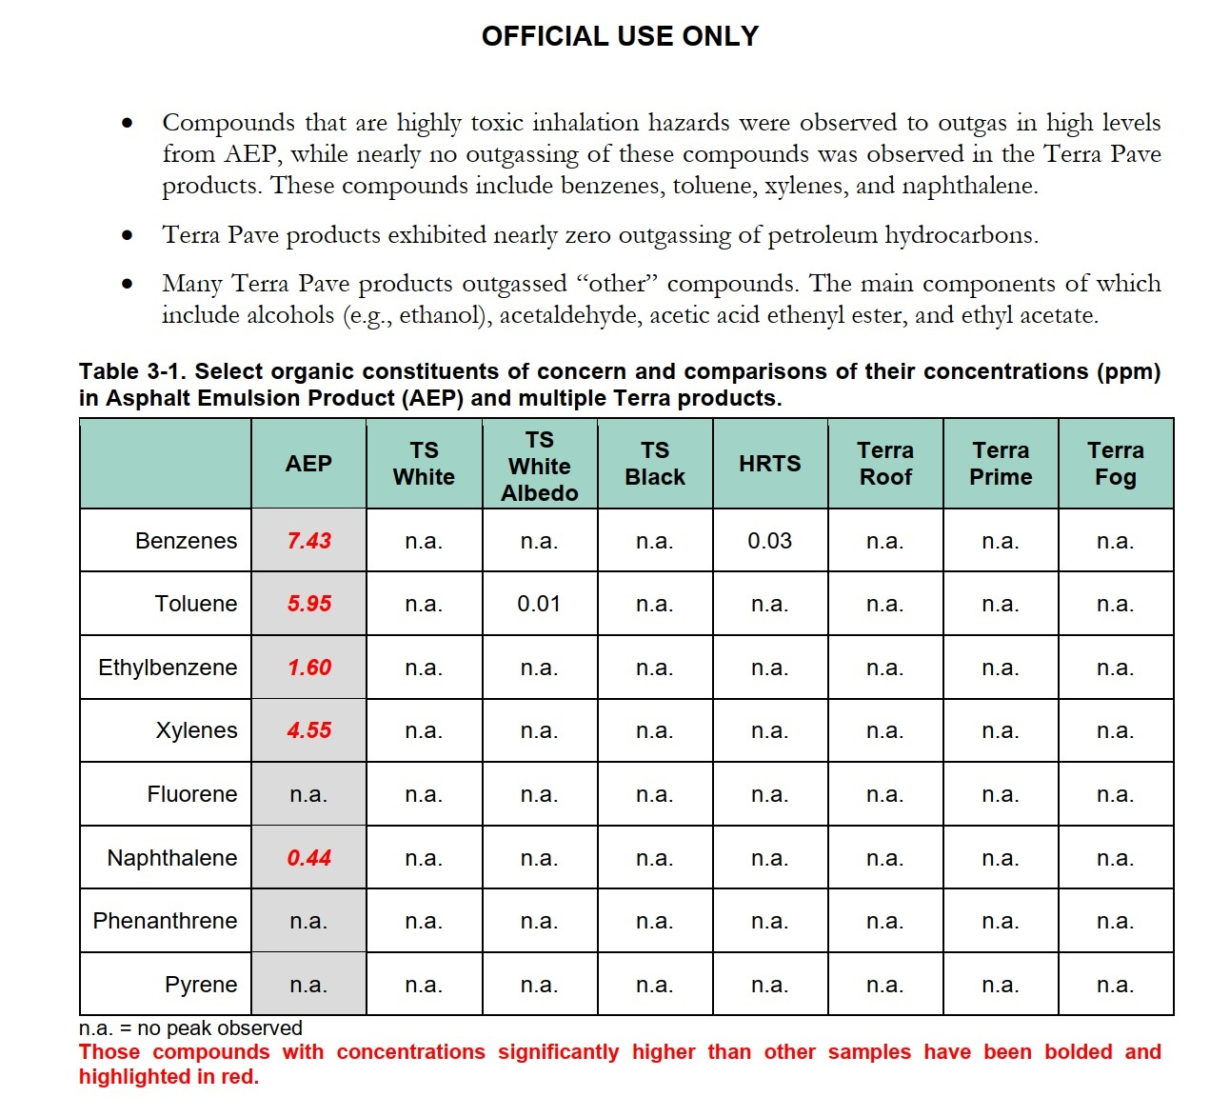
Tests Completed as
100% ECO-FRIENDLY
By
More details of ECO-FRIENDLY test results can be downloaded: https://www.terrapavetech.com/terrapave/sandia.pdf
Notes:
We can fix current pavements, build new pavements, and lower city temperatures with cooler pavements

Slide 35
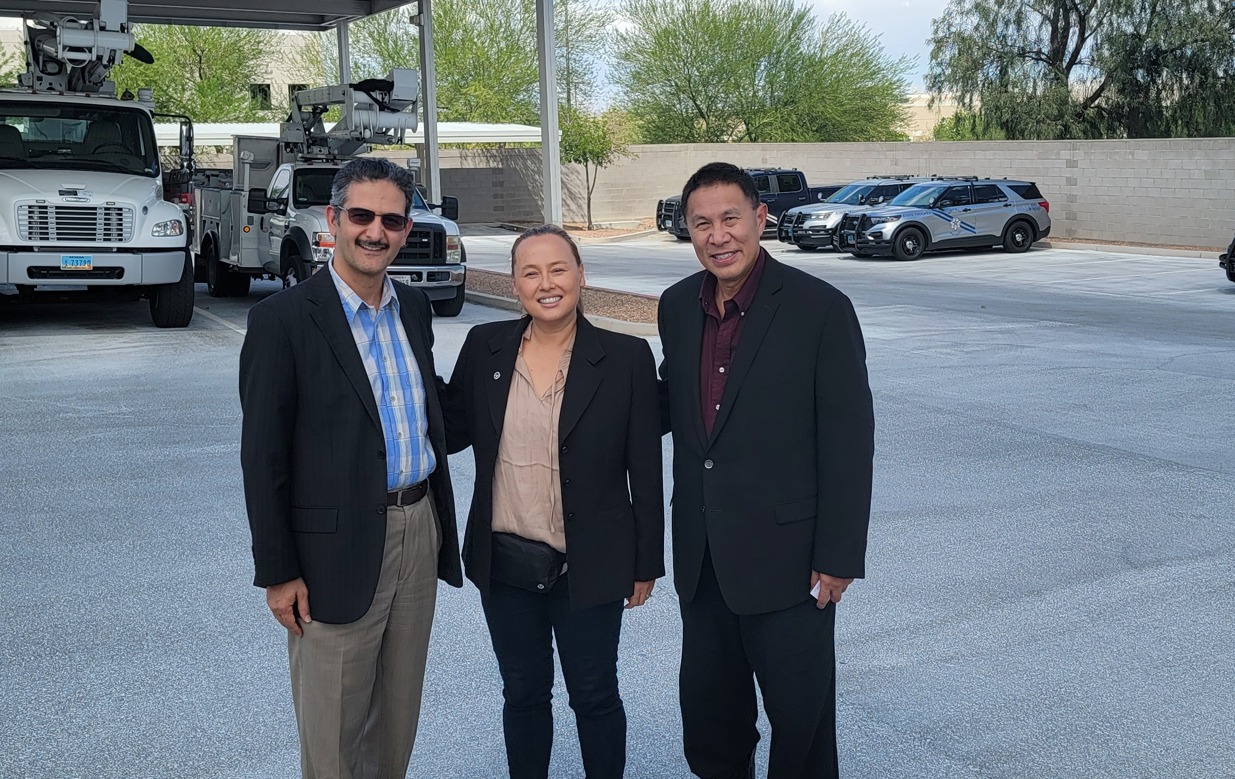
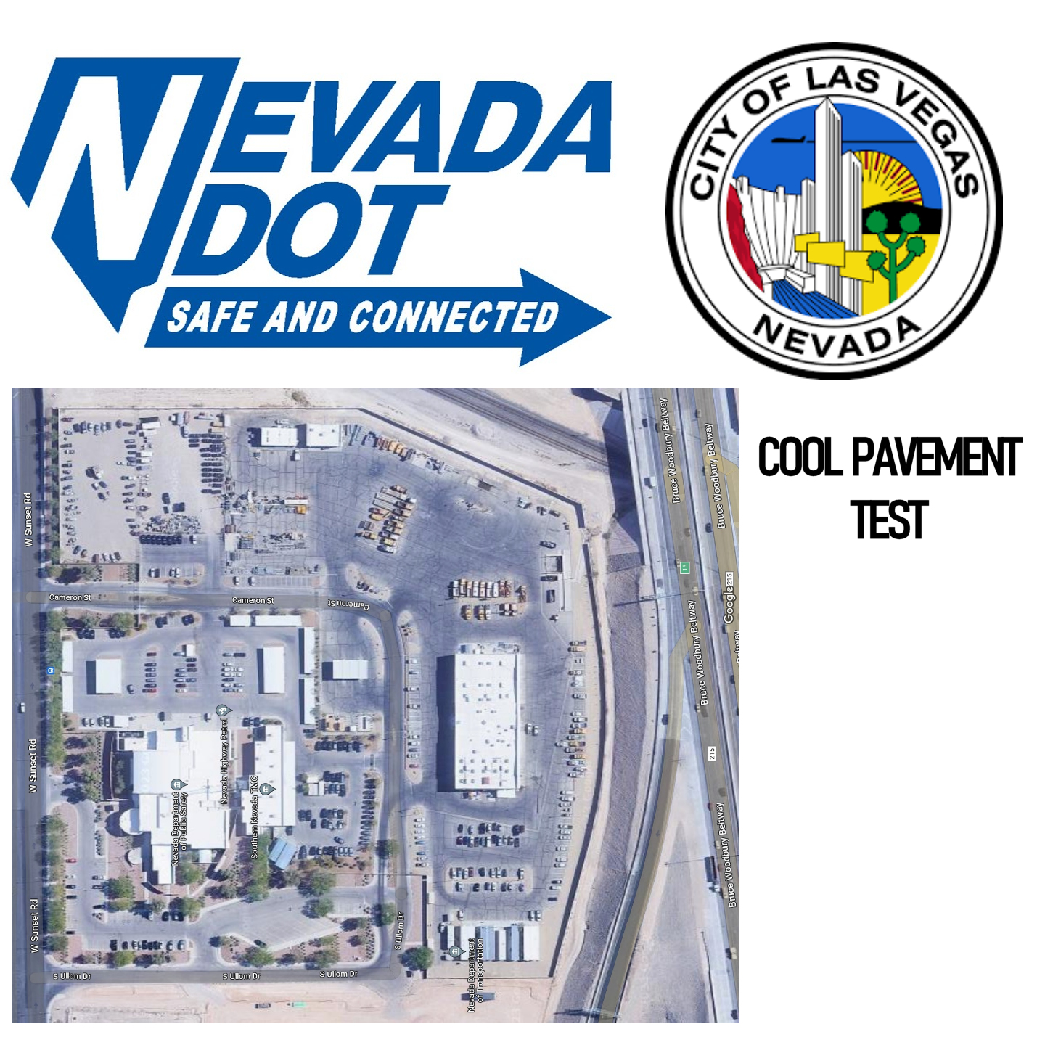

Department of Transportation Nevada - Terra Pave Cool Pavement™ (TPCP) (TPCP: 0.03 gal/square yard) = -18 degree F cooler
PDF Download
https://youtu.be/9_IFH_twIl0

Slide 36

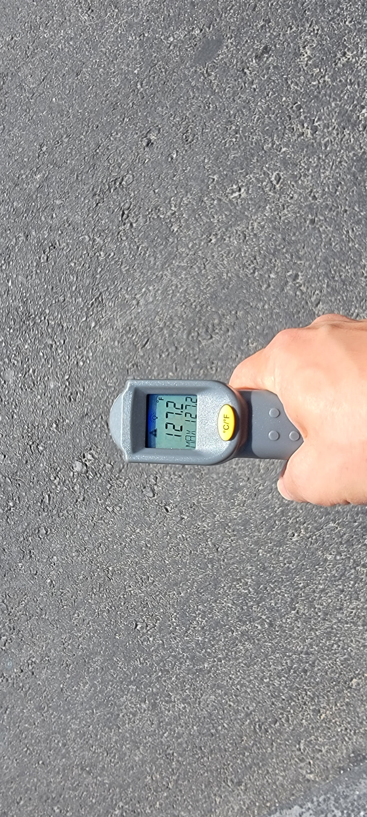
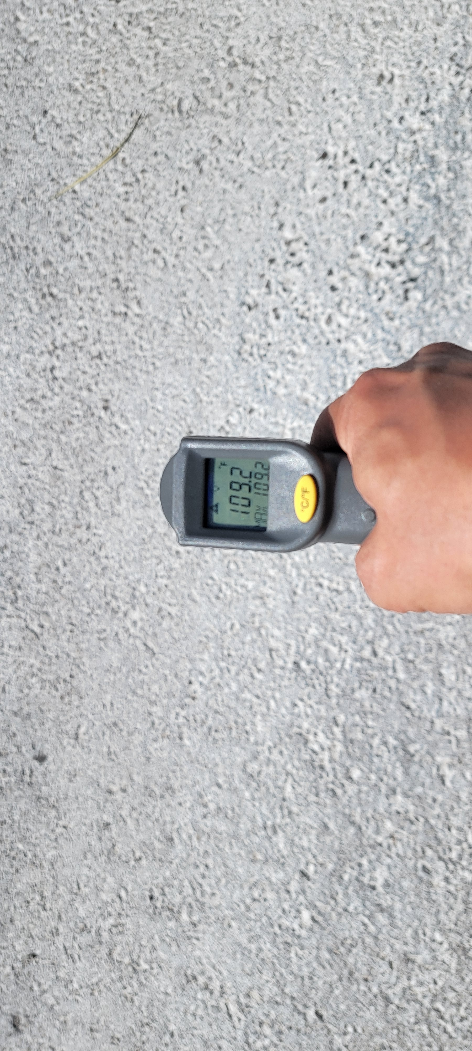
Asphalt Surface
@ 127.2 degrees F
Terra Pave Cool Pavement @ 109.2 degrees F
Lowered -18 degrees F
* Urban Heat Island Mitigation
* Makes the roads/pavements Cooler 18+ degree F or more
* Energy Saving for the entire city
* Improves Air Quality
* Improves Health and Comfort for the entire city
* Preserves existing Asphalt/Chip Seal
* Seals current roads/pavements from Water Penetration to sub-soil
* Extends the Life of the roads/pavements +6 years depending on the traffic
* Improves Traction and Shorten Braking distance
* When cured roads/pavements have a grayish-white color and 100% Eco-Friendly
* Climate Change Mitigation

Slide 37
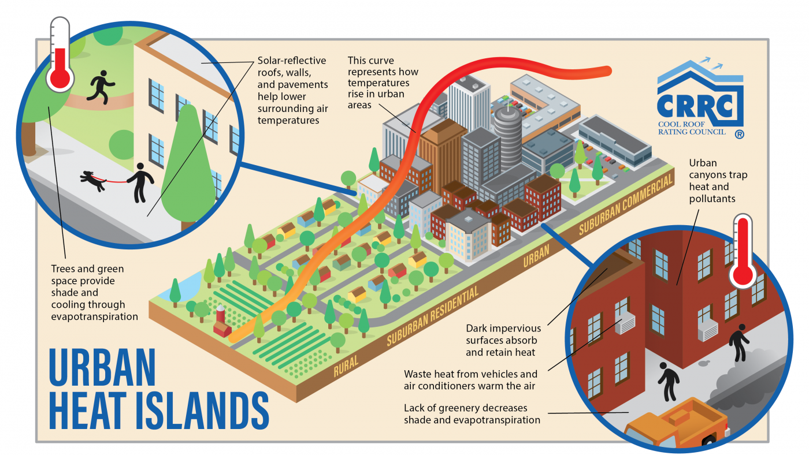
Urban Heat Islands (UHI) – Causing Poverty, Death, Decrease Quality of Life
Extreme heat events – caused more fatalities than hurricanes, tornadoes, and floods combined.
UHI disproportionately affects low-income residents and communities much more than wealthier neighborhoods.
https://climate.mit.edu/explainers/urban-heat-islands

Slide 38


Maximize Energy Production for Bifacial Solar Farms
Ground Covering
Materials
Variable,
Changes
#1
Fixed

Slide 39








Challenges for Bifacial Panels - ALBEDO
Challenges for Bifacial Panels – albedo surface
Solved to these Challenges with TERRA PAVE Products
A
Bifacial adoption is happening much faster than anticipated Without a lasting solution for ALBEDO
B
DEVELOPERs, EPCs, INVESTORs – MODELING ENERGY
Modeling energy production of bifacial systems is in very early stages, but likely on the conservative side
C
DEVELOPERs, EPCs – DESIGN, ENGINEERING
Project economics are overwhelmingly favorable, but design and optimization require new ways of thinking
D
DEVELOPERs, INVESTORs – PRODUCTION PERFORMANCE
Performance guarantees will be challenging, but international standards will be necessary to pave the way
DEVELOPERS, EPCs, INVESTORS, MANUFACTURERS, LAND OWNERS,
UTILITIES, PEOPLE & LIVING SPECIES OF THE EARTH

Slide 40


Maximize Production of Bi-Facial/Mono-Facial Solar Farm 365 days
Maximize ALBEDO 365 days
Eliminate Weed/Vegetation Control
Control Dust on Solar Panels
Control Erosion of ground
Last +20 years
100% Eco-Friendly
Bi-Facial Solar Farm
Mono-Facial Solar Farm
Notes:
Terra Pave is 3x stronger than Cement Stabilization

Slide 41

BETTER
BEST PSI STRESS & STRAIN
TERRA PAVE WHITE
The life expectancy of roads will be significantly extended 2x-4x times,
Vastly superior Road-Base stability,
A tremendous increase in Strength and a significant reduction in Permeability.
CEMENT STABILIZATION
More details of PSI Strength, Stress & Strain % test results can be downloaded: https://www.terrapavetech.com/terrapave/tswstrength01.pdf
https://www.terrapavetech.com/terrapave/tpwtests.pdf
https://www.terrapavetech.com/terrapave/tswcement.pdf
BETTER

Slide 42
3X STRONGER THAN CEMENT STABILIZATION
TERRA PAVE
TERRA PAVE
TERRA PAVE
Stronger
1 MPa = 145 PSI
Notes:
Terra Pave is 3x stronger than Cement Stabilization

Slide 43
Cement Modulus base stabilization
Cement Modulus base stabilization
Cement Modulus base stabilization
1 MPa = 145 PSI
(Megapascal)

Slide 44
1 MPa = 145 PSI
(Megapascal)

Slide 45

WATERPROOF = NO POTHOLES/CRACKS
More
Permeable
USEPA STANDARD
1x10-7 cm/sec
1.0E-07
Less Permeable
Permeability Coefficient
2.9E-09
The USEPA standard of 1x10-7 cm/sec. it would take liquid 4.76 years to traverse 15 cm.
Soil Type: Sandy Loam
Top-Seal treated soil, at 2.9x10-9 cm/sec. the liquid would need 16.4 years to go through 15 cm.
Less
Permeable
Notes:
100% waterproof

Slide 46
TERRA PAVE WHITE

Slide 47


(California Bearing Rate)

Slide 48



Pavement Preservation
Higher is BEST
Asphalt Emulsion Product - SS1 Bitumen Emulsions
Asphalt Emulsions
Asphalt Emulsion Product - Cationic CSS-1 Asphalt Emulsions

Slide 49

Pavement Preservation
Higher is BEST
Asphalt Emulsion Product - Cationic CSS-1 Asphalt Emulsions
Asphalt Emulsion Product - SS1 Bitumen Emulsions
Asphalt Emulsions

Slide 50
Terra Pave White + Terra Prime (New road)
15 cm Base + Cement
15 cm Base + TP White
Superior Quality, Waterproof Strong Base Layer, Fast to Traffic Able, Lower Cost, More Eco-Friendly
Notes:
TP is ship in 55 gal drum or 275 gal tote Made in Texas

